Slide 1

The Family Planning Spending Assessment
(FPSA) Approach
Notes:
Welcome to the Family Planning Spending Assessment (FPSA) training.
If you have not done so already and are interested in learning more about the basics of FP expenditures, you can access Track20's FP Costing 101: Costing and Economic Evaluation for Family Planning Programs, an online training course meant to provide family planning professionals with the tools to conduct basic costing exercises and analyses to help with program planning, evaluation, and monitoring. This training is available on the Track20 Tools & Trainings page at http://www.track20.org/pages/track20_tools/tools.php.

Slide 2
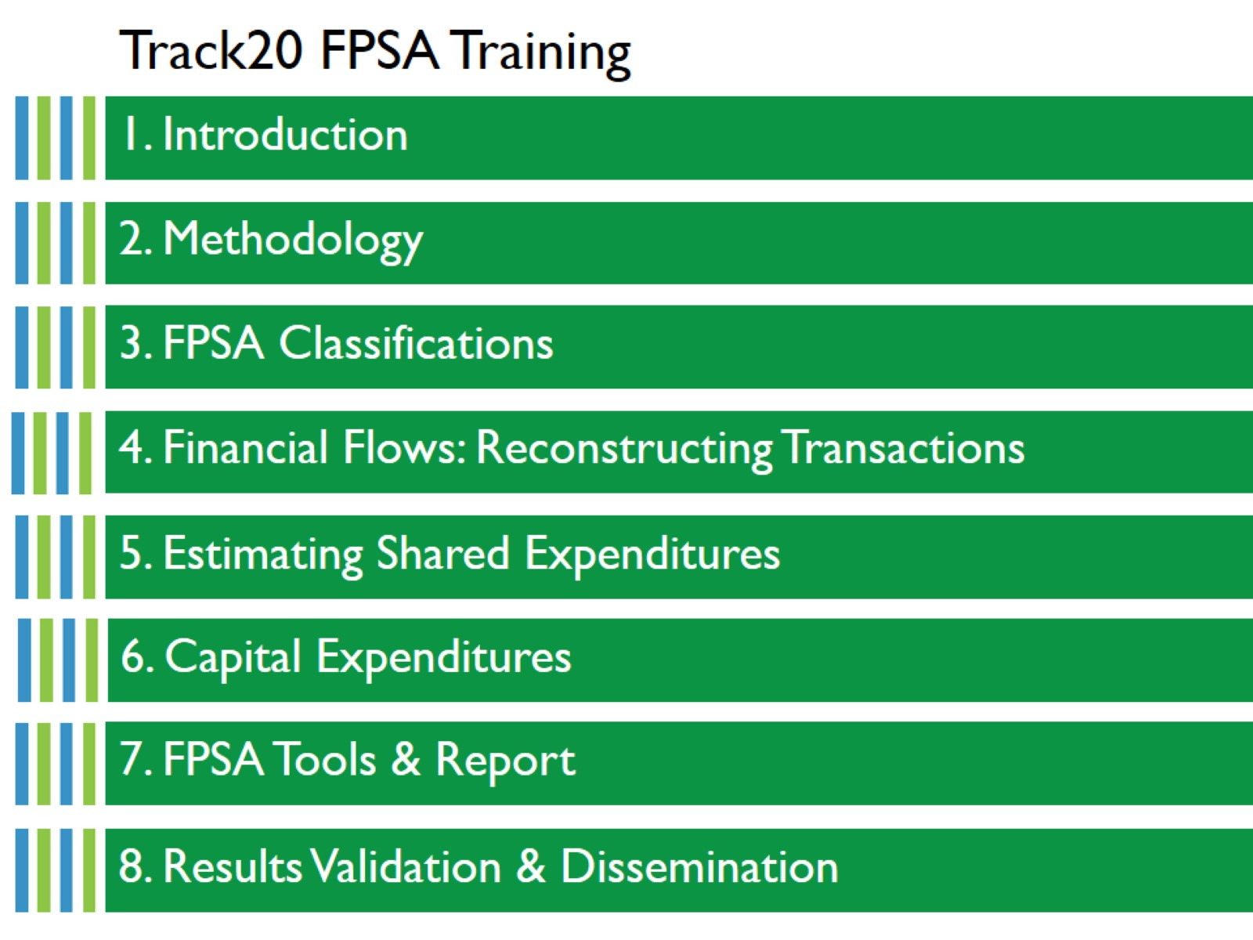
Track20 FPSA Training
Notes:
This training will introduce Track20’s Family Planning Spending Assessment (FPSA) methodology, walk you through concepts and calculations important to the process, and how results are reported and disseminated.

Slide 3

1. Introduction
Notes:
This section will introduce the Family Planning Spending Assessment and provide information on the background and motivation of gathering FP domestic expenditures.

Slide 4
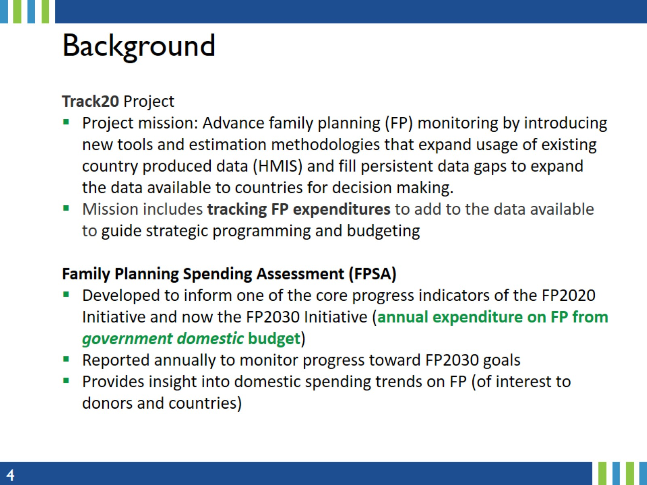
Background
Notes:
The Family Planning Spending Assessment (FPSA) was developed by the Track20 project, which is implemented by Avenir Health. Track20 was funded by the Bill and Melinda Gates Foundation to advance the current family planning (FP) monitoring environment by introducing new tools and estimation methodologies that expand the usage of existing country produced data (HMIS) and fill persistent data gaps to expand the data available to countries for decision making.
With other partners, Track20 tracks expenditure data as part of its mission to increase the expenditure available and improve accountability and oversight for FP programs.
The FPSA was first developed to inform one of the core progress indicators for the global Family Planning 2020 (FP2020) initiative: annual expenditure on FP from government domestic budget. FP2020, the first global initiative focused solely on FP, was an outcome of the 2012 London Summit on Family Planning where more than 20 governments and major donors made commitments to address the policy, financing, delivery, and socio-cultural barriers to women accessing contraceptive information, services, and supplies.
The follow-on initiative, FP2030, has maintained an indicator tracking FP expenditures from government domestic resources, though the indicator no longer includes donors’ funding and budget support, which were included in the FP2020 indicator.

Slide 5
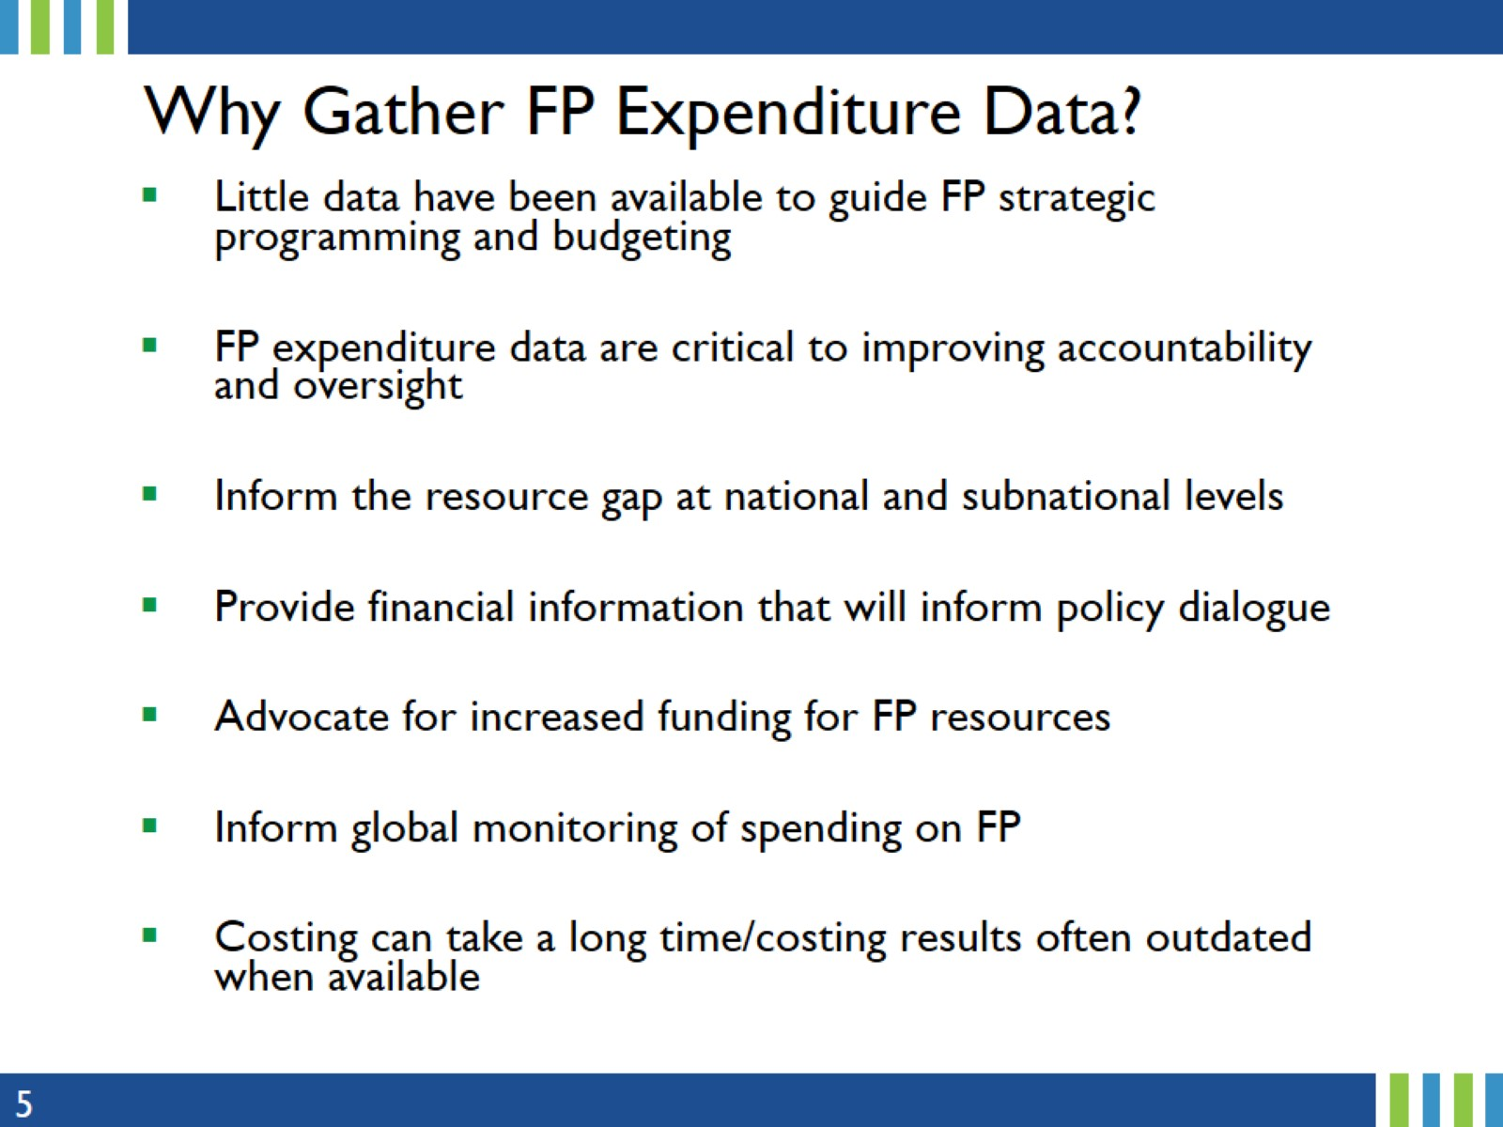
Why Gather FP Expenditure Data?
Notes:
Why are FP2030, Track20, and the Family Planning field in general, interested in expenditures?
There are various reasons for gathering expenditures data:
Little data have been available to guide FP strategic programming and budgeting – FPSA is a way to increase available data.
FP expenditure data are critical to improving accountability and oversight.
Inform the resource gap at national and subnational levels.
Provide financial information that will inform policy dialogue.
Advocate for increased funding for FP resources.
Inform global monitoring of spending on FP overtime.
Costing can take a long time/costing results often outdated when available – this adds a different data source.

Slide 6
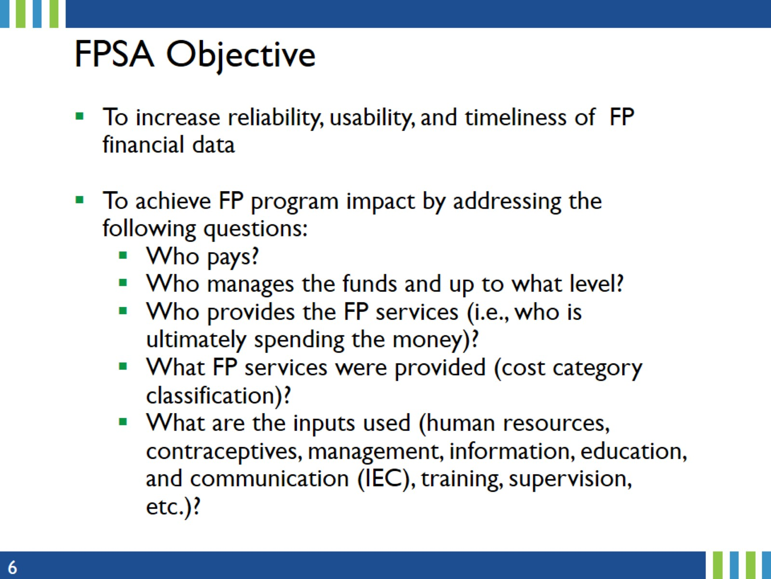
FPSA Objective
Notes:
The FPSA Methodology was developed to fill the gap in FP expenditure data and support data-driven decision making.

Slide 7
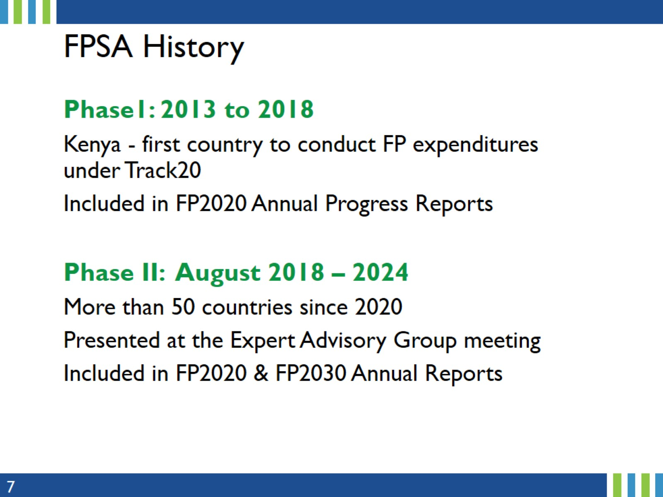
FPSA History
Notes:
The first FPSA was conducted in Kenya in 2013. By 2018, 11 countries had FPSAs. The number of countries completed varied, with five being the most completed in a single year
Track20 expanded FPSA efforts greatly in phase 2, and in 2020 Track20 completed 41 FPSAs. By 2024 more than 50 countries had FPSAs.
Results have been reported annually in the FP2020, and now FP2030 Progress Report through the FP2030 Indicator “Annual expenditure on family planning from government domestic budget”, with multi-year trends now are available for many countries.

Slide 8
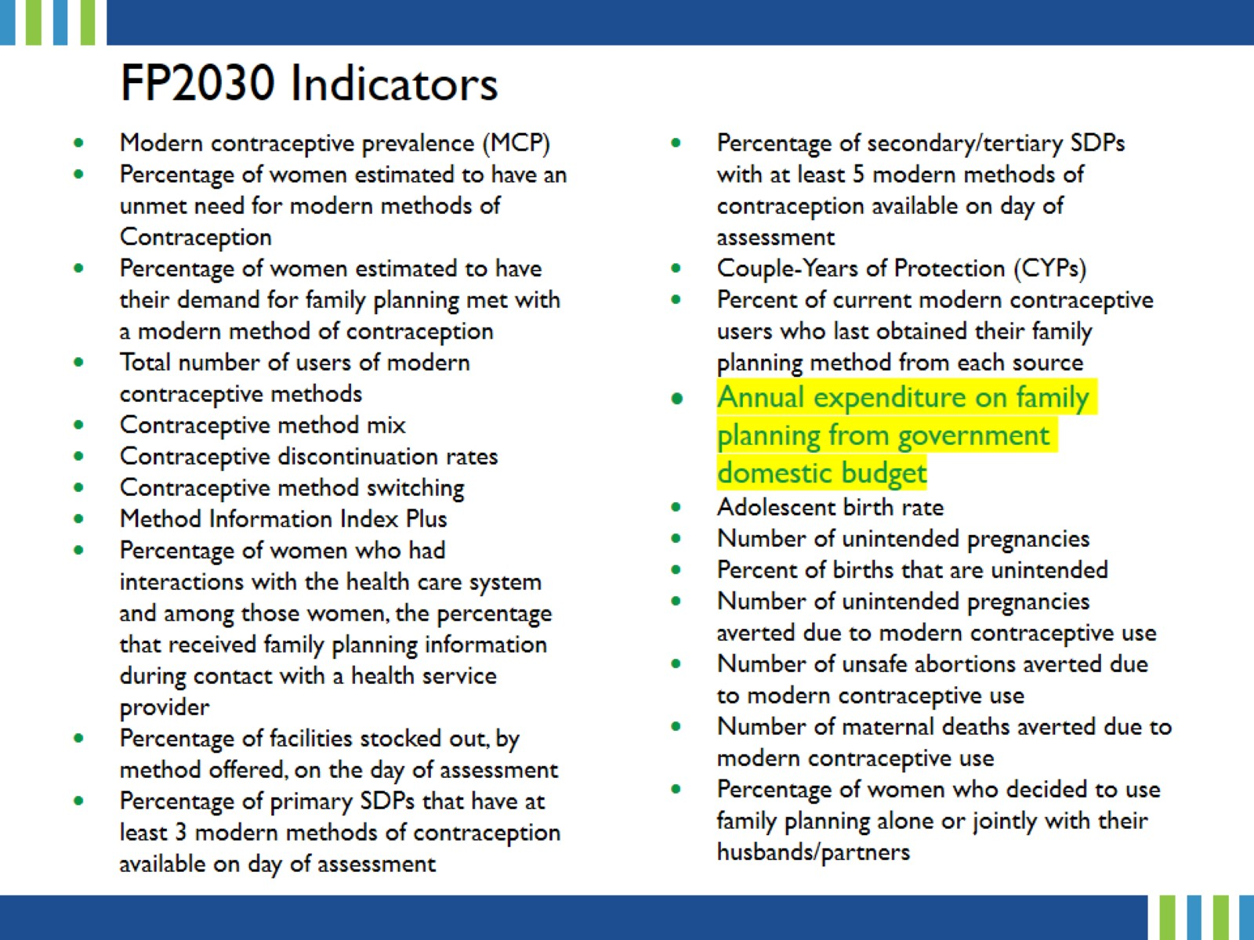
FP2030 Indicators
Notes:
“Annual expenditure on FP from government domestic budget” is just one of the indicators reported annually to the FP2030 global initiative. The list of indicators is available here: https://www.track20.org/pages/data_analysis/core_indicators/overview.php.

Slide 9
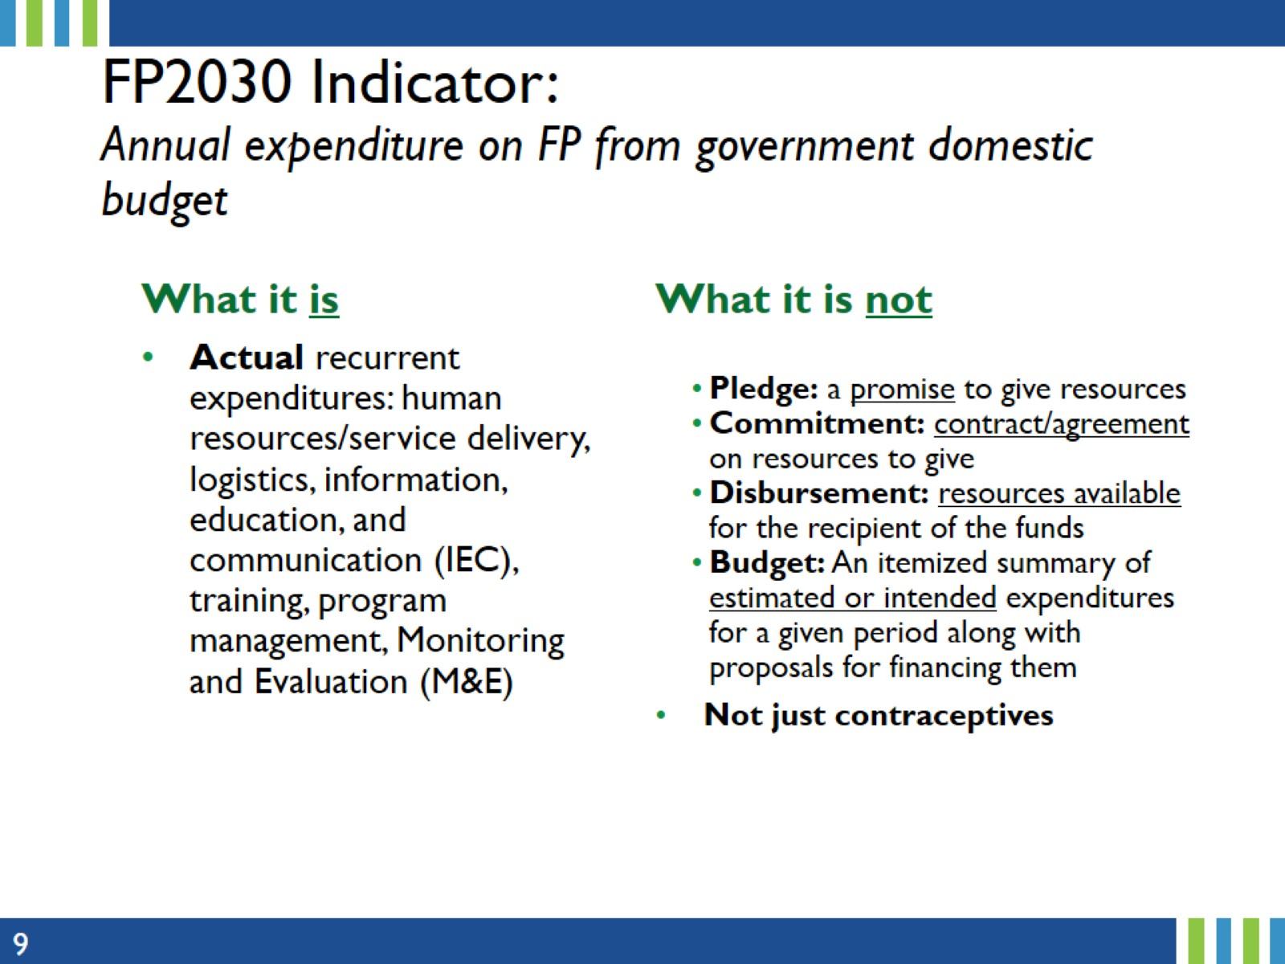
FP2030 Indicator:
Annual expenditure on FP from government domestic budget
Notes:
Let’s take a moment to look carefully at what the indicator is measuring. ACTUAL recurrent expenditures. Many FP expenditures are not FP-specific – and often, there is no specific FP line item in the budget. In these cases, FP-specific expenditures need to be estimated. Resources are anything needed to complete a project including financial, personnel, equipment, ...
More details will be provided on this later in the presentation.

Slide 10
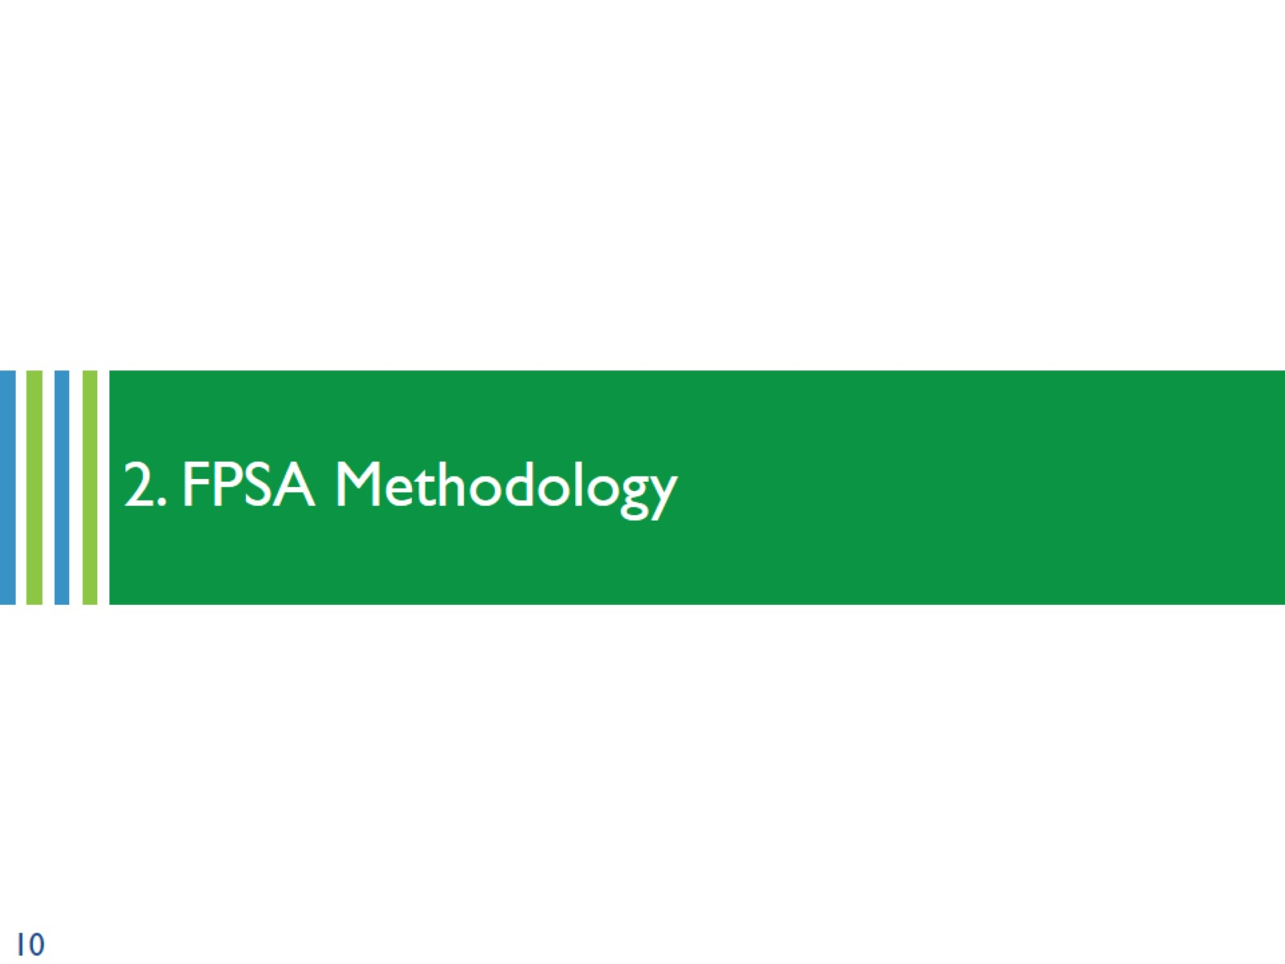
2. FPSA Methodology
Notes:
This section provides details on the Family Planning Spending Assessment core methodology.

Slide 11
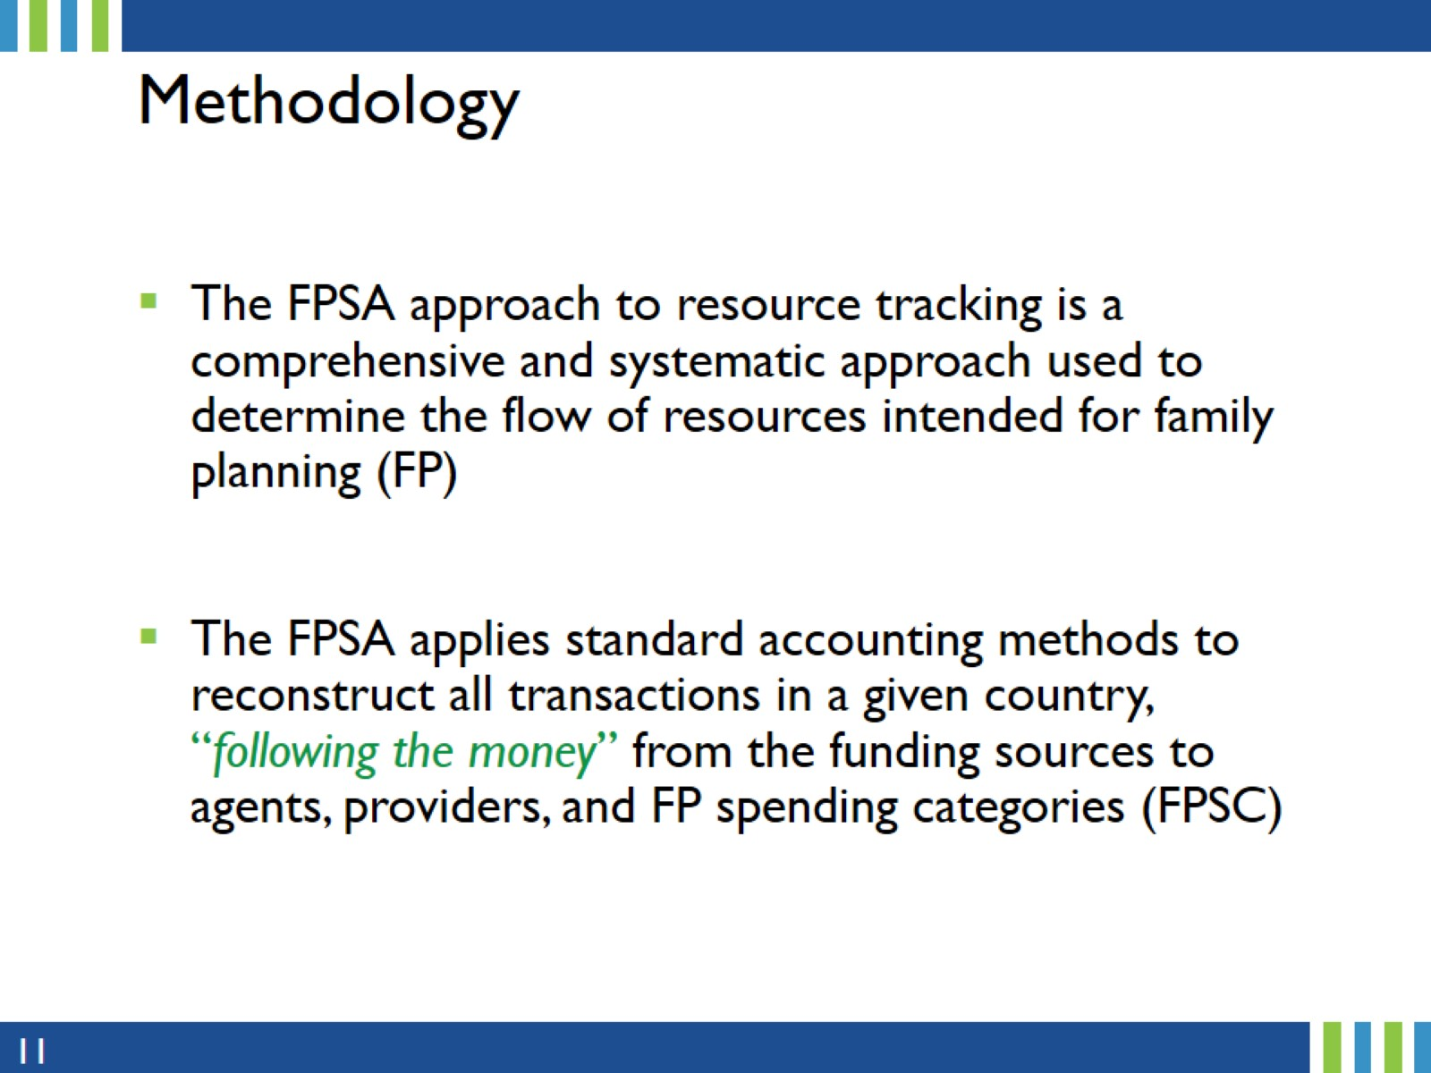
Methodology
Notes:
The FPSA focuses specifically on domestic government FP expenditures.
Expenditure data can provide timely, routinely-reported data for decision-makers to make inform FP program planning decisions.
It was therefore important to develop a standard and harmonized methodology to ensure consistency across the board.

Slide 12
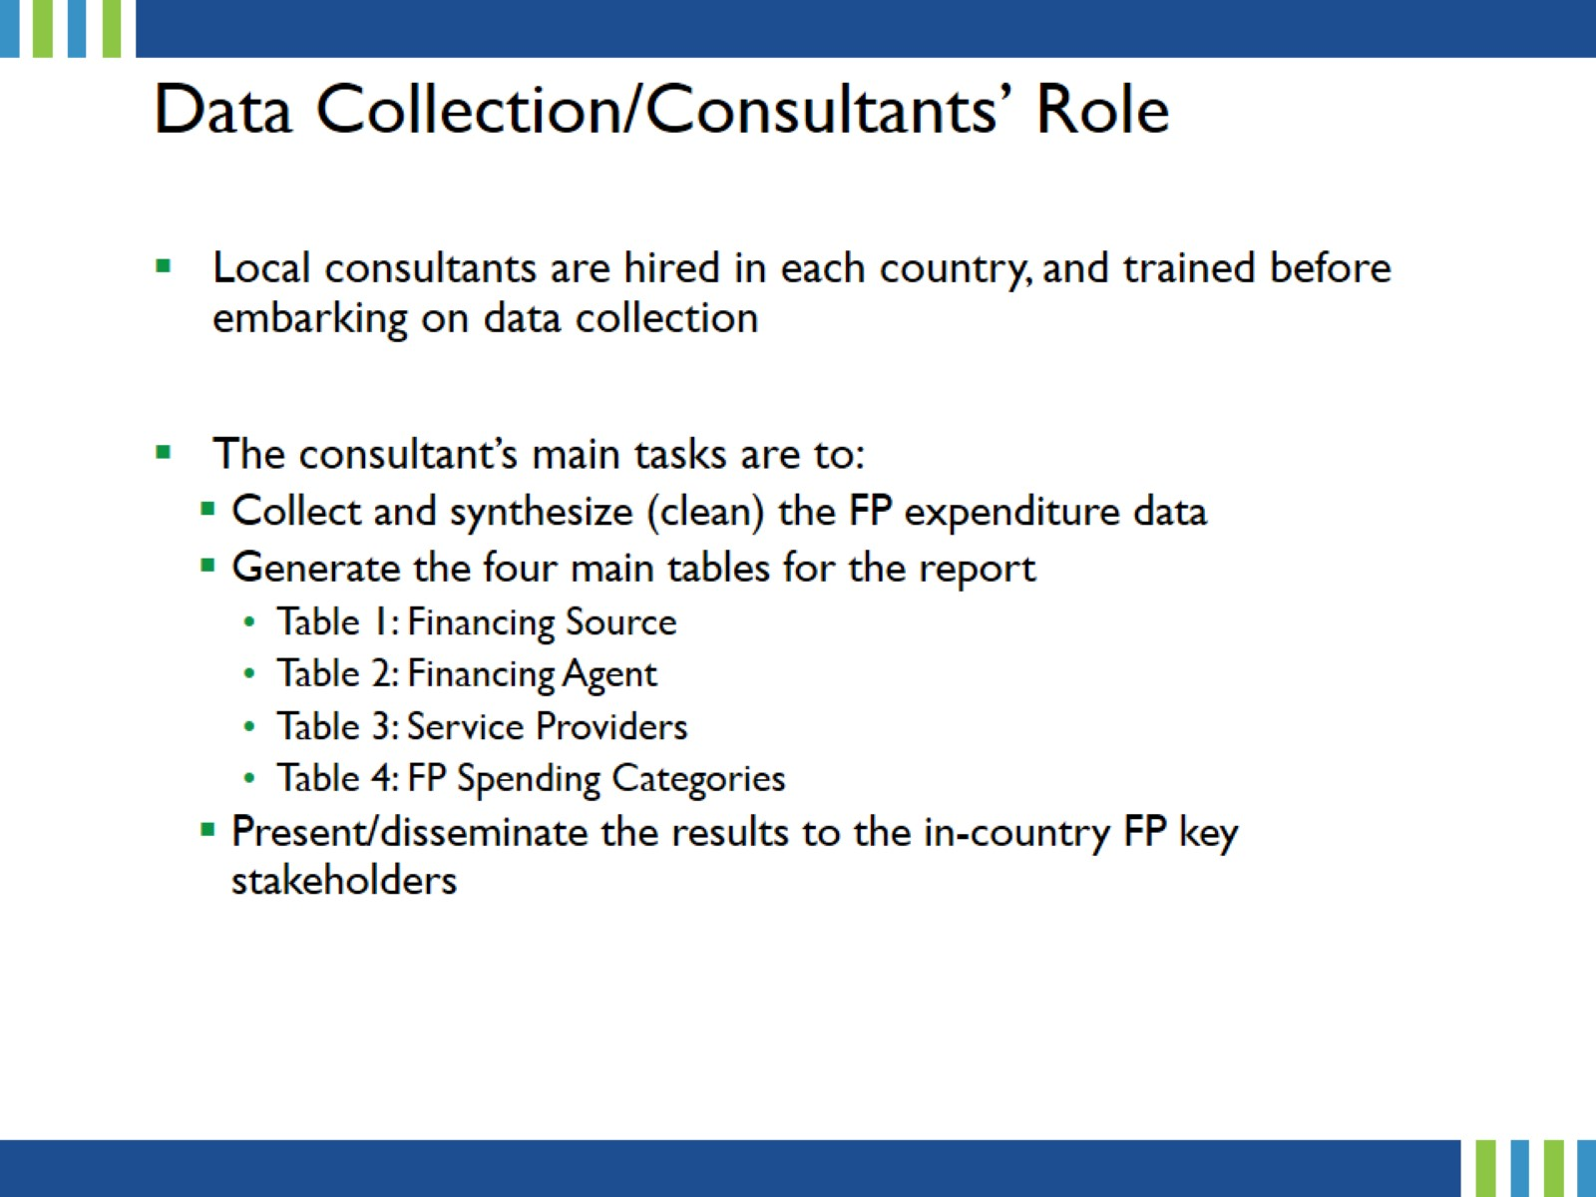
Data Collection/Consultants’ Role
Notes:
Local consultants play a key role in the FPSA process. They are trained on the FPSA process by Avenir Health staff soon after they are hired.
Their main responsibilities are to collect the data, generate the tables for the report, and ensure that the FPSA results are validated by the in-country key FP stakeholders. When a Track20 Monitoring & Evaluation (M&E) Officer is available in a country, the consultant should work closely with them on result validation and dissemination.
The validation meeting may be incorporated into the agenda of the Government’s Annual Data Consensus Meeting or organized as a standalone FP Expenditure validation meeting.
Consultants may be called upon by the government or the Track20 M&E Officer to present the FPSA results during the Data Consensus meeting.
More details will be provided on the role of the Track20 M&E Officer and the Government’s Annual Consensus Meeting/FP expenditures validation meeting later in the presentation.

Slide 13
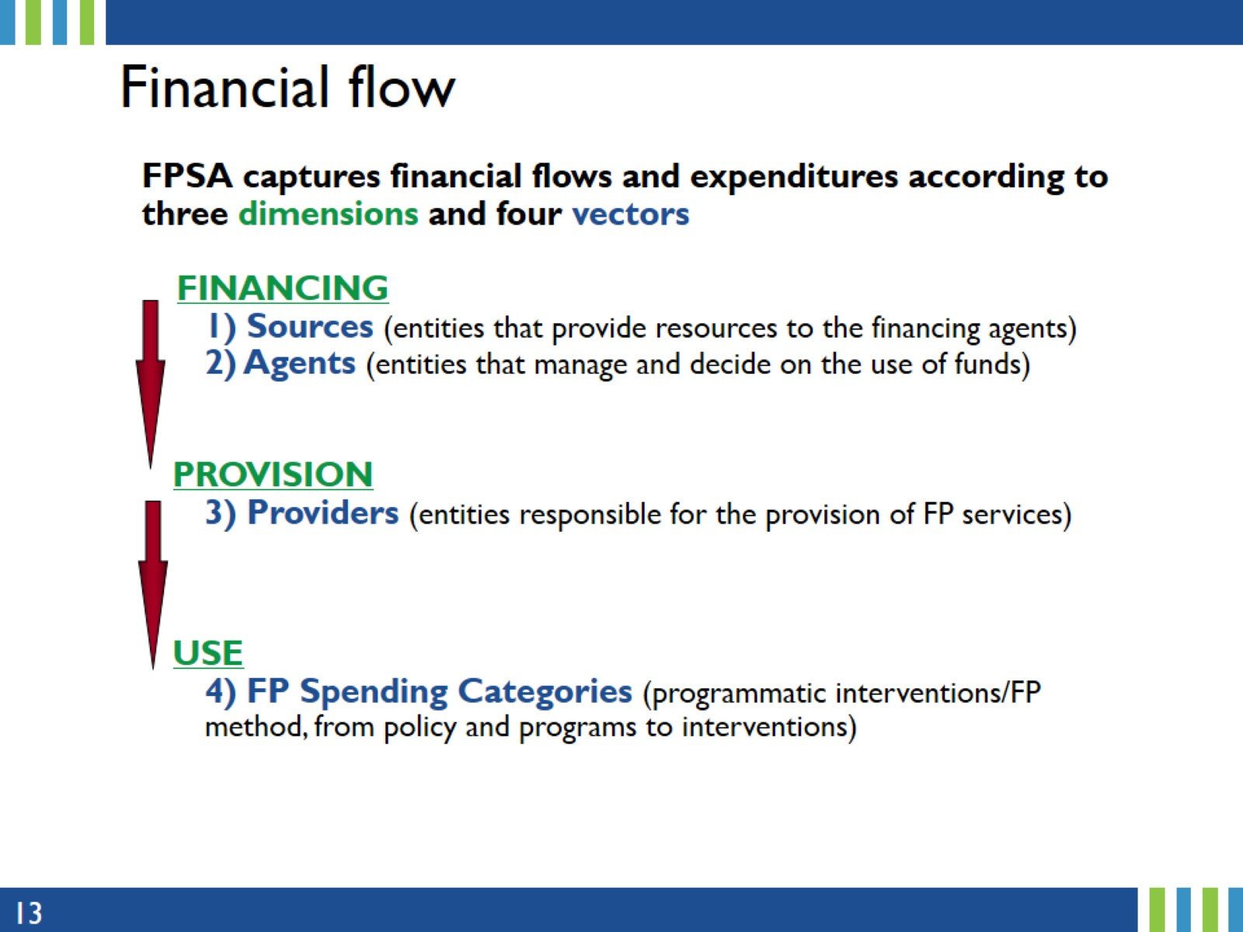
Financial flow
Notes:
FPSA captures financial flows and expenditures according to three dimensions and four vectors:
The Financing dimension – includes Finance Sources, which are entities that provide resources to the Financing Agents. Financing Agents and purchasers are economic/institutional units/entities that manage and decide on the use of funds for payment or purchase of FP services, FP commodities. They collect revenue, pool financial resources, pay for service provision, and make programmatic decisions (allocation and purchase modalities).
In the Provision Dimension, we have Service Providers, which are entities responsible for the or engaged in the production, provision of services.
In the Use dimension, there are the FP Spending Categories, which reflect programmatic interventions/FP method, from policy and programs to interventions (FP-related interventions and activities)
We will come back to this slide in a subsequent presentation.

Slide 14
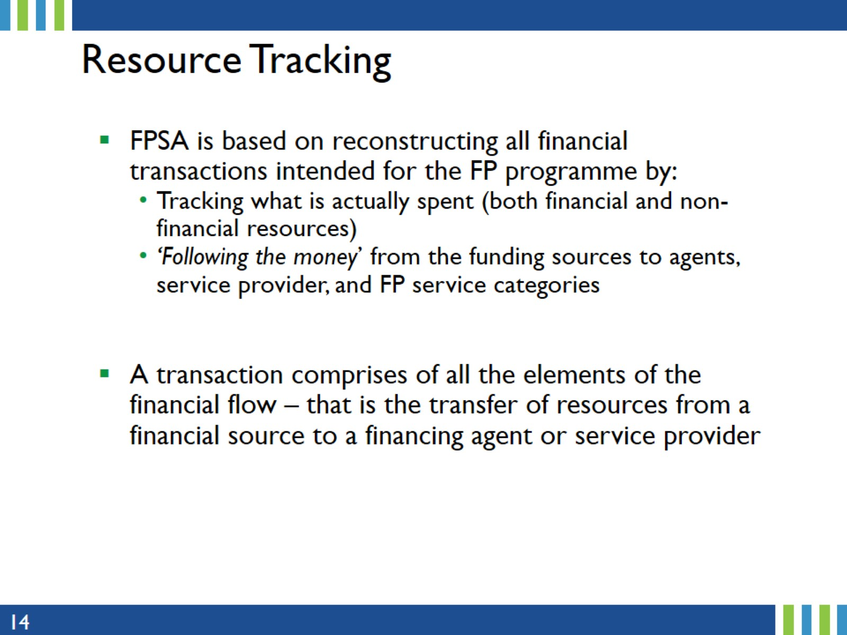
Resource Tracking
Notes:
Resource tracking is the process of monitoring how resources are assigned and used over time.
FPSA tracks what is spent (both financial and non-financial resources) by ‘Following the money’ (that is by examining money transfers/transactions between parties) from the funding sources to agents, service provider, and FP service categories.

Slide 15
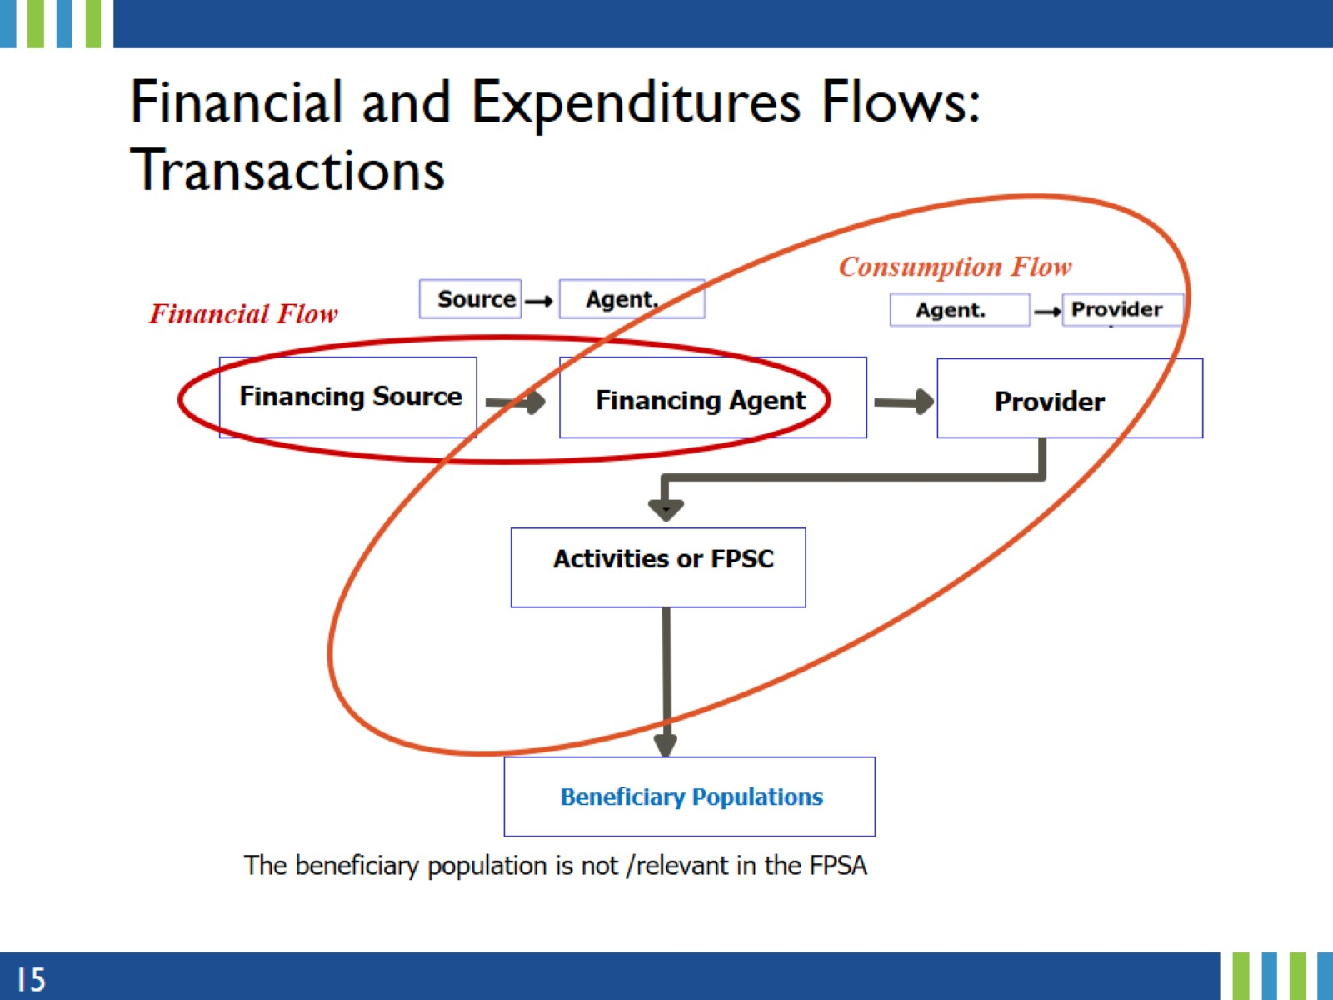
Financial and Expenditures Flows:
Transactions
Notes:
This is an example depicting the flow of the transactions (financial flow and consumption flow) from the financing source up to the beneficiaries - though the FPSA stops at the activity level (FPSC). The FP spending categories are what the funds are spent on.
Here, the financial flow is between the Financing Source and the Financing Agent, while the consumption of FP goods is between the Financing Agent, Service Providers and Beneficiaries
More details on Financial and Expenditures Flows and how to reconstruct the transactions are provided in a subsequent presentation.

Slide 16
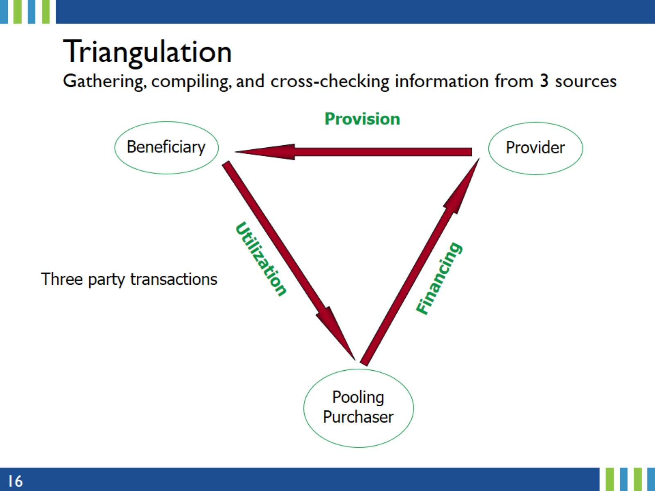
Triangulation
Gathering, compiling, and cross-checking information from 3 sources
Notes:
Data triangulation is a strategy that involves using multiple data sources.
The goal is to increase the validity and reliability of the results by corroborating findings and compensating for weaknesses in one data source with the strengths of others.
The three-way transaction is simply to indicate that the funds committed by the pooling purchaser or financial source/agent (Financing) should be the same as what the Service Providers spent (Provision) as well as what is spent on the FP categories such as personnel, contraceptives/consumables, Logistics, ... (Utilization).

Slide 17
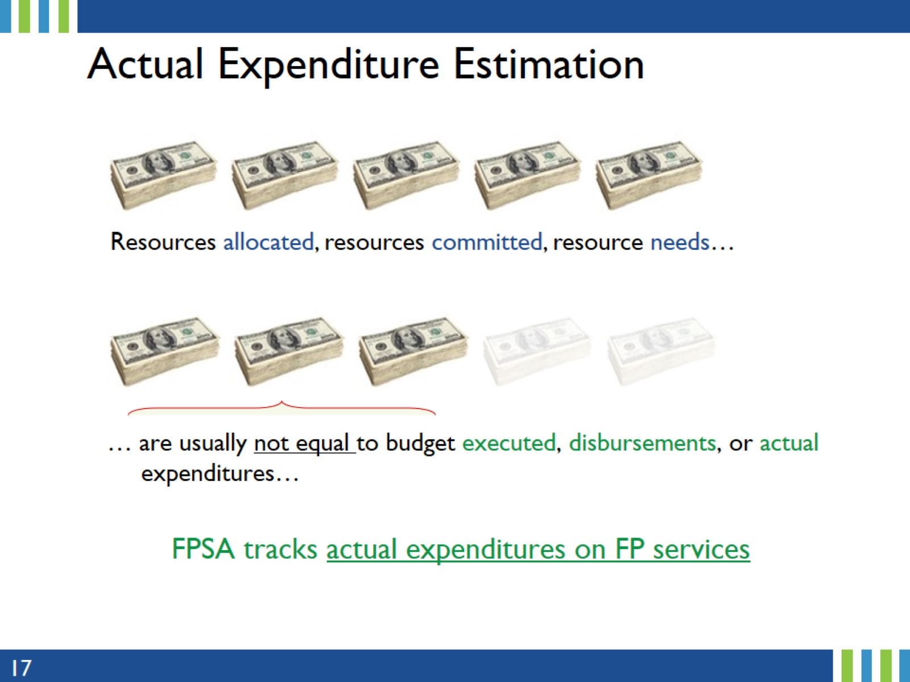
Actual Expenditure Estimation
Notes:
FPSA focuses on actual expenditures – it is important to understand how that is different from other common terms used in this area – resources allocated, committed, needed…
Resource needs/requirements are the personnel, material, equipment, and other miscellaneous resources needed to complete the work.
Resource allocation is the process of identifying and assigning available resources to projects, tasks, or activities.
Committed resources are resources (time, money, or materials) promised/dedicated to be provided in a plan of action.
Some of these key terms (pledge, commitment, budget) are defined in the next slide.

Slide 18
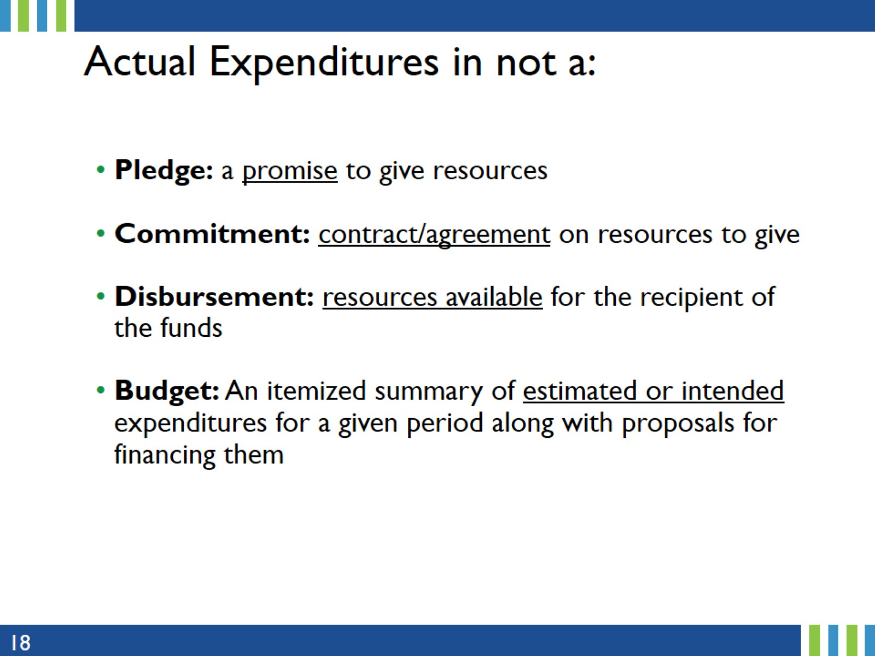
Actual Expenditures in not a:
Notes:
While these were already mentioned in a previous slide, it is important to refresh our memory here.
Because FPSA tracks actual FP expenditures, it is important to re-emphasize on the key terms encountered that could be confused with actual expenditures.

Slide 19
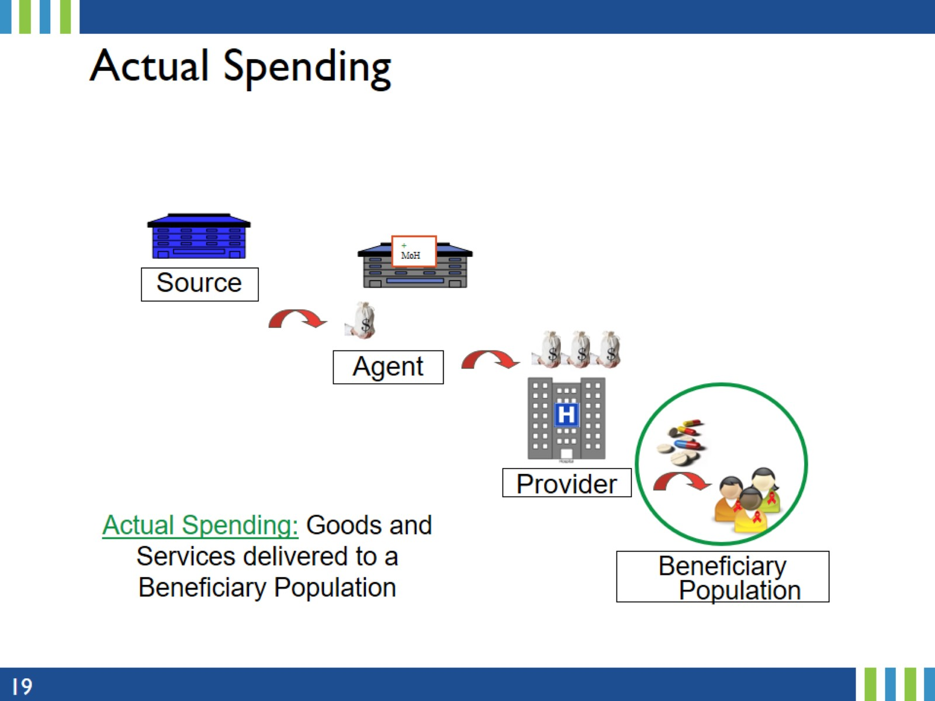
Actual Spending
Notes:
FPSA focuses on actual spending.
Actual expenditures is the value of finished goods and services, that is the total amount of cash/goods spent during a period.

Slide 20
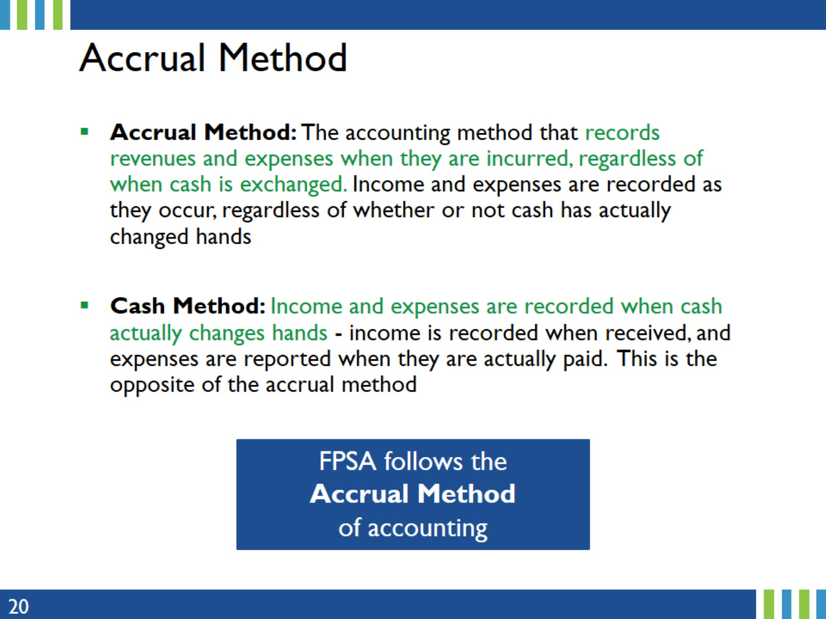
Accrual Method
Notes:
Consultants/data collectors will encounter a variety of accounting practices in the field, some accrual and other cash
Recommendation: Follow accrual method to the extend possible

Slide 21
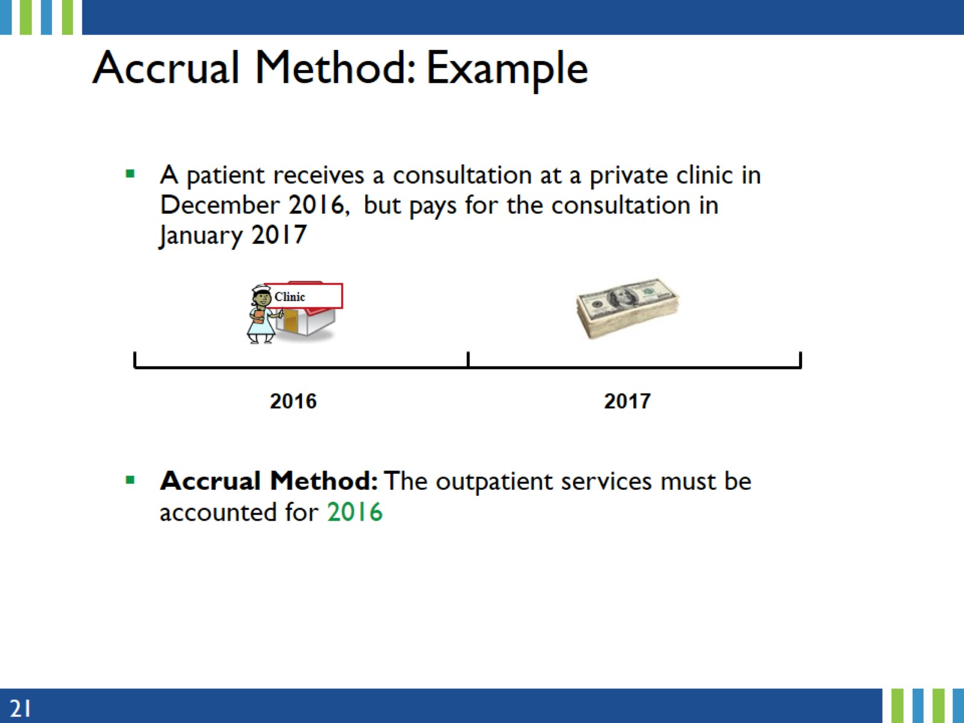
Accrual Method: Example
Notes:
In this example, the expenditure is accounted for 2016 because FPSA follows the Accrual Method of accounting (accrual method). The cash basis of accounting will record this as 2017 expenditure.
Always follow the Accrual Method.

Slide 22
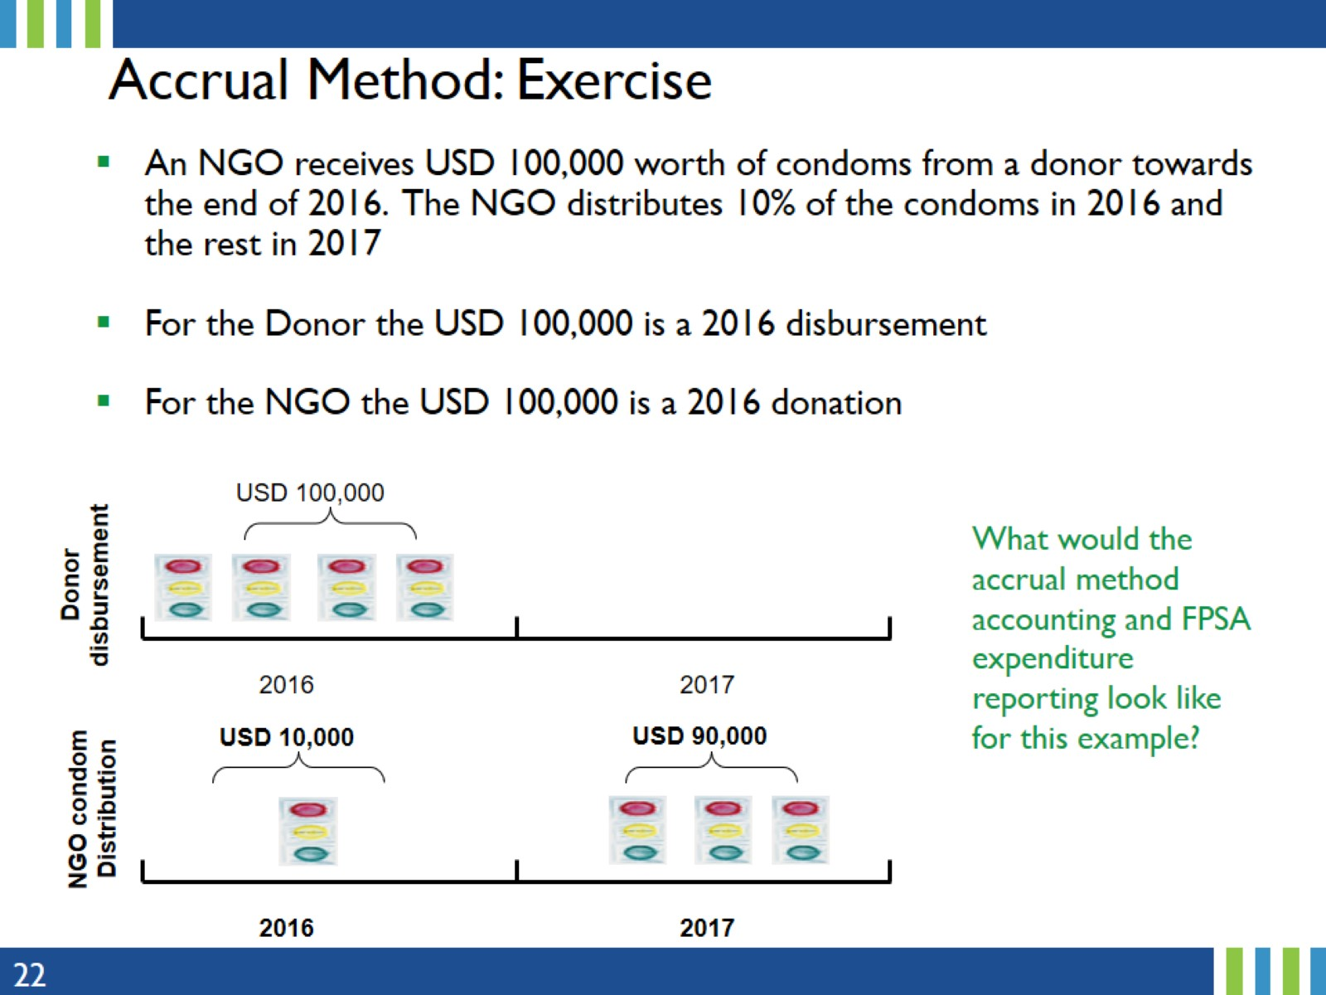
Accrual Method: Exercise
Notes:
This is a slightly more complex example of what consultants will encounter on the field.
Note the word “distribution” here. The percent distribution is is key in determining what the FPSA 2016 and 2017 expenditures will look like.

Slide 23
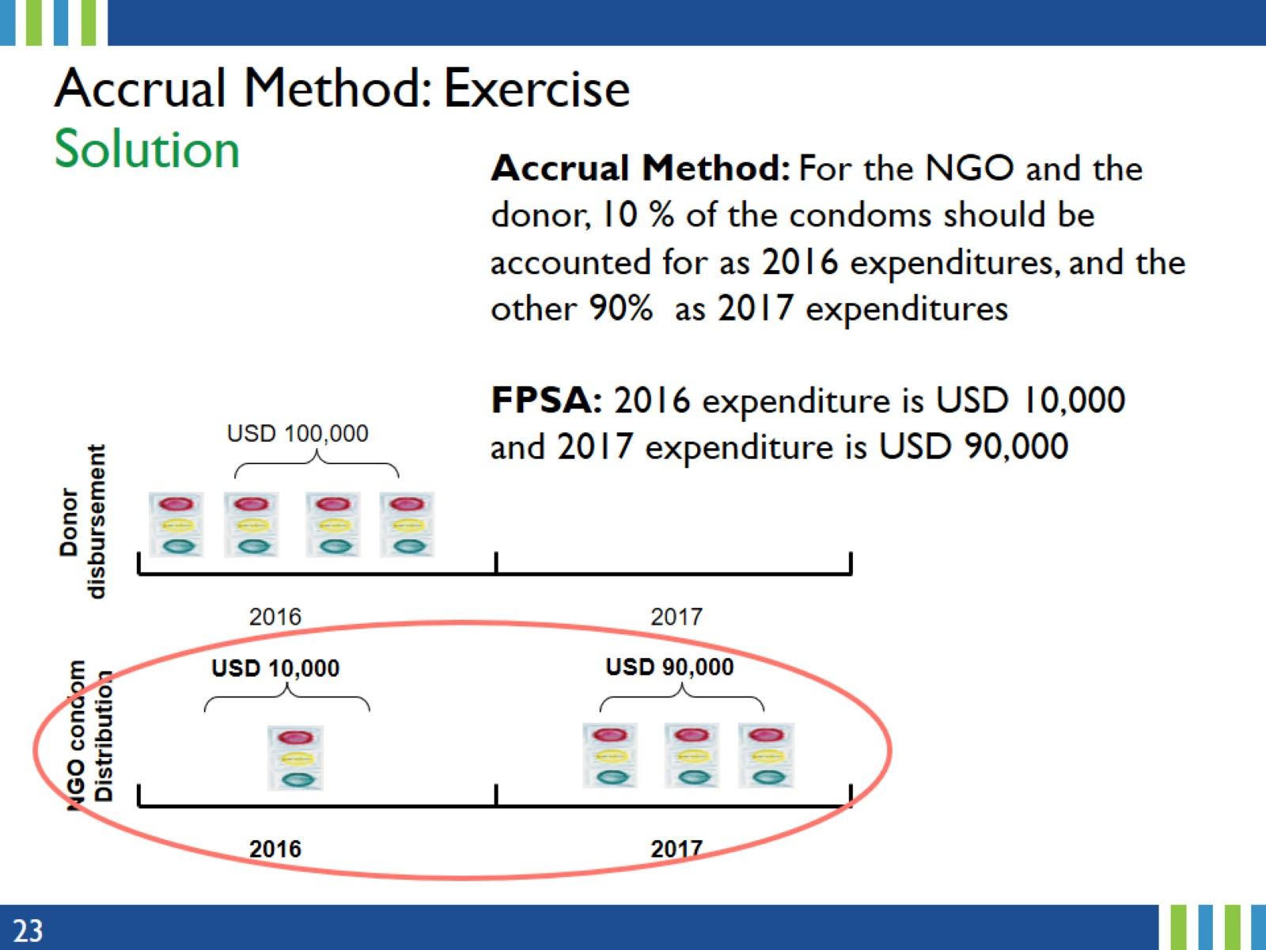
Accrual Method: Exercise
Solution
Notes:
Since FPSA follows the accrual method, that is expenses are recorded as they occur, regardless of whether or not cash actually changed hands, using the distribution key, respectively USD 10,000 and USD 90,000 will be recorded as 2016 and 2017 FP expenditures.

Slide 24
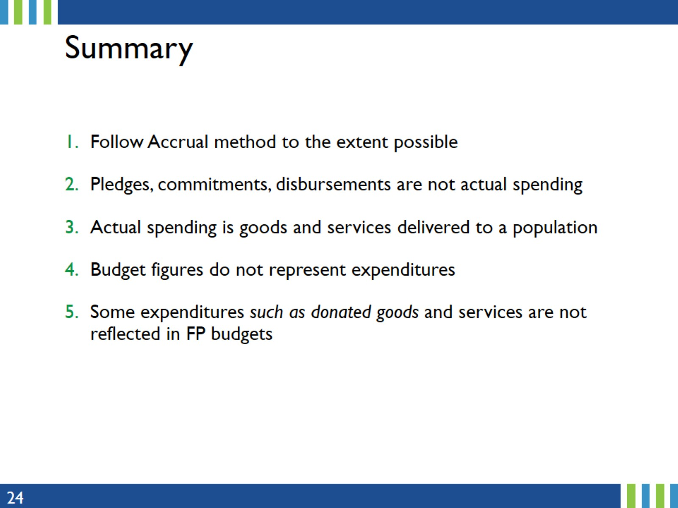
Summary
Notes:
The key take aways from this section are summarized on this slide.
Always follow Accrual method of accounting and record records expenditures when they are incurred, regardless of when cash is exchanged.
Most expenditure categories (personnel, ...) are from the ‘entire’ health systems and should be estimated.
More details on the estimation process of shared expenditures are provided in a subsequent presentation.

Slide 25
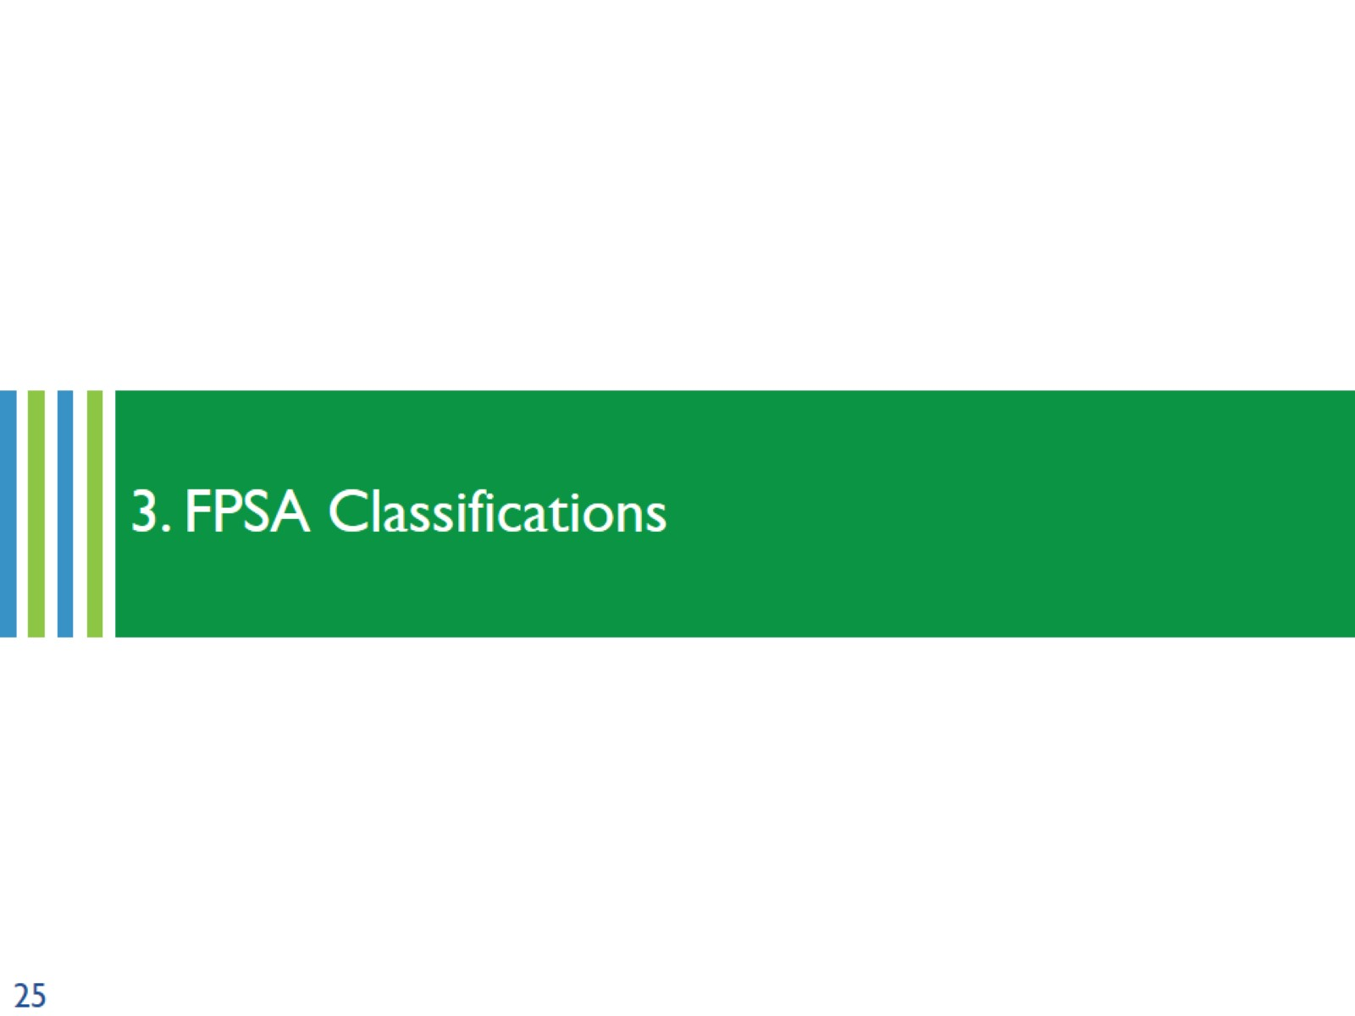
3. FPSA Classifications
Notes:
Since the FPSA uses an approach derived from the National AIDS Spending Assessment (NASA) methods, the FPSA classifications also follows the same method of classification but applied to FP.
This section provide information on the classification, which ensures the FP categories are mutually exclusive and exhaustive.

Slide 26
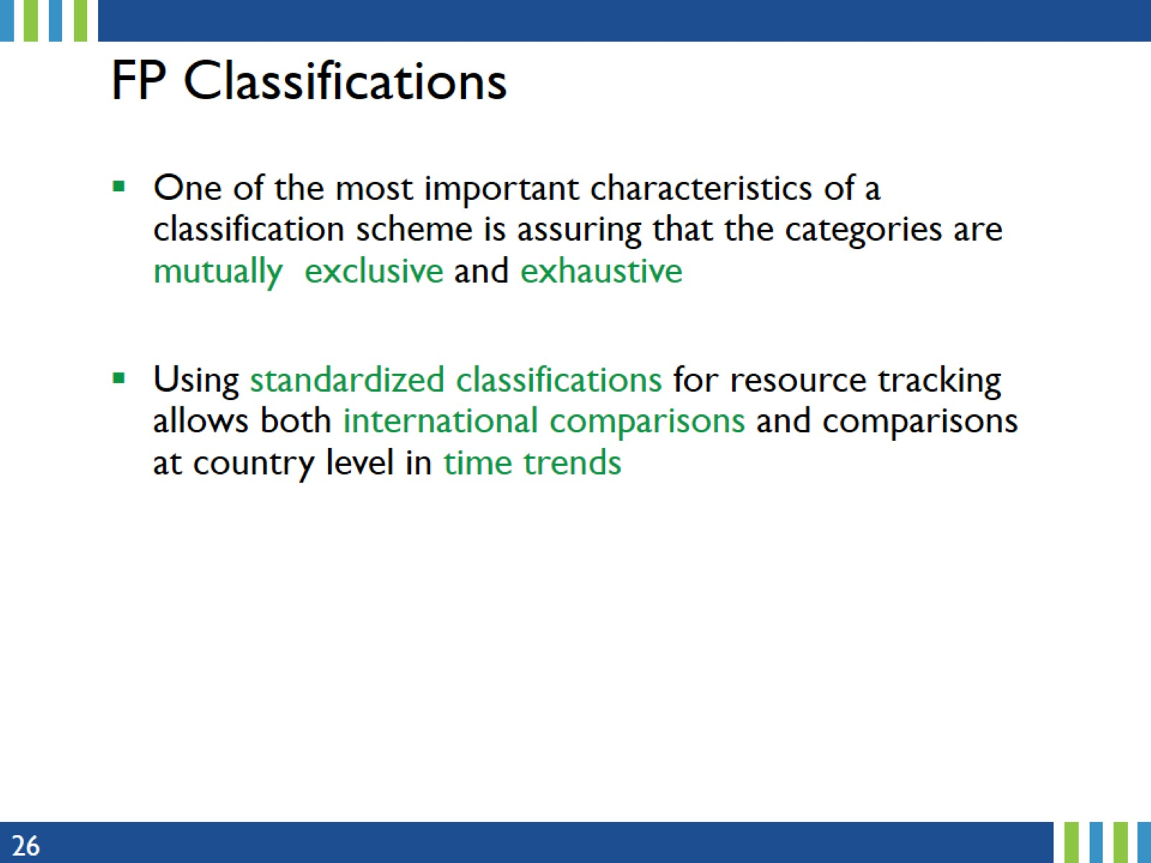
FP Classifications
Notes:
Standard and harmonized FP classifications are important in financial tracking for country trends, and international comparisons.

Slide 27
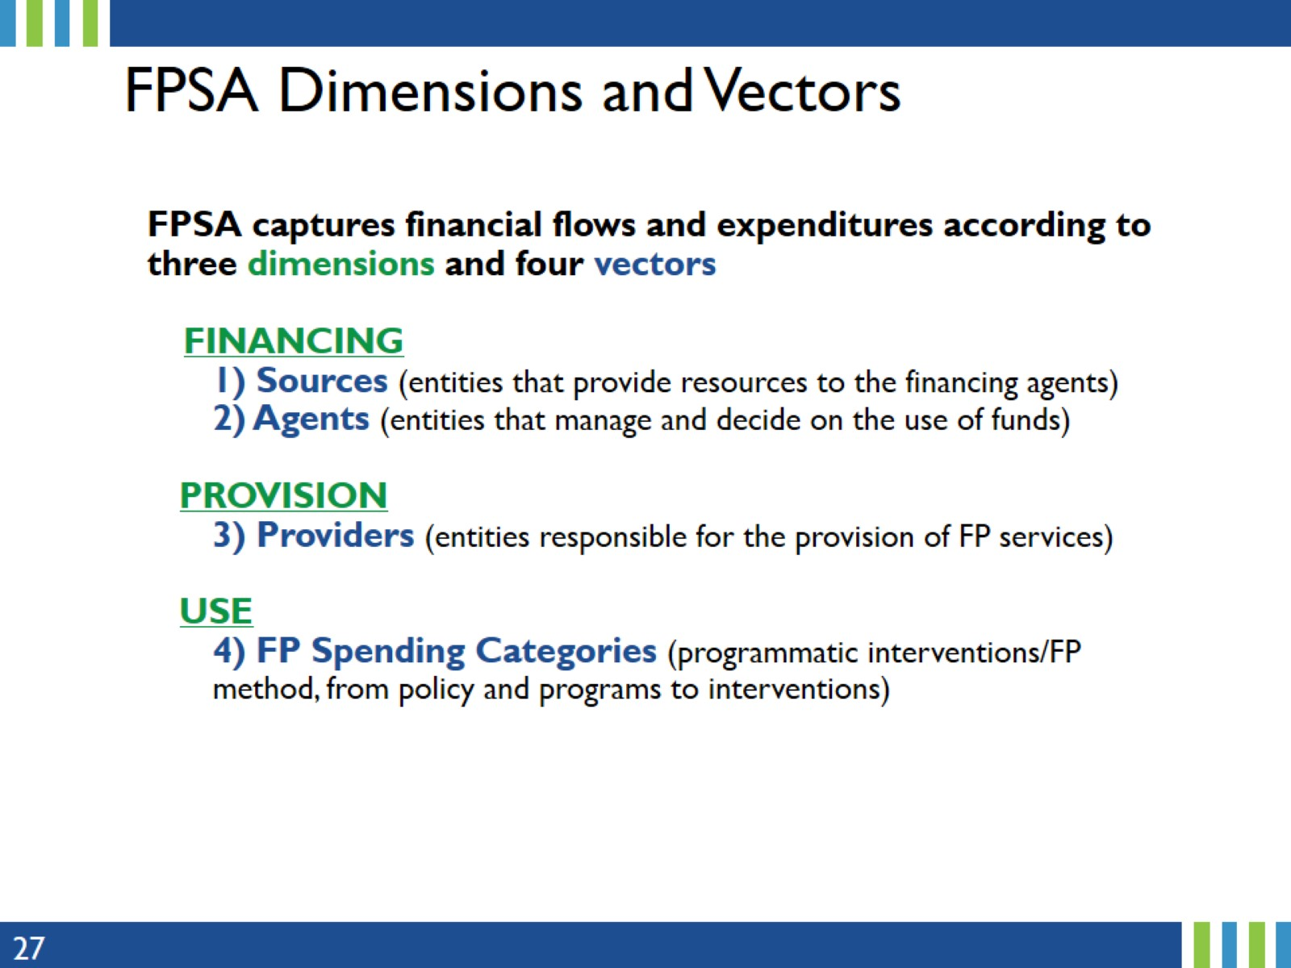
FPSA Dimensions and Vectors
Notes:
As mentioned previously, FPSA captures financial flows and expenditures according to three dimensions and four vectors.
Under the Financing dimension, Financing Sources are entities that provide resources to the Financing Agents.
Financing Agent and purchasers are economic/institutional units/entities that manage and decide on the use of funds for payment or purchase of FP services, FP commodities. They collect revenue, pool financial resources, pay for service provision, and make programmatic decisions (allocation and purchase modalities).
Under Provision, Service Providers are entities responsible for the or engage in the production, provision FP of services.
And under Use, FP Spending Categories reflect programmatic interventions/FP method, from policy and programs to interventions (FP-related interventions and activities).

Slide 28
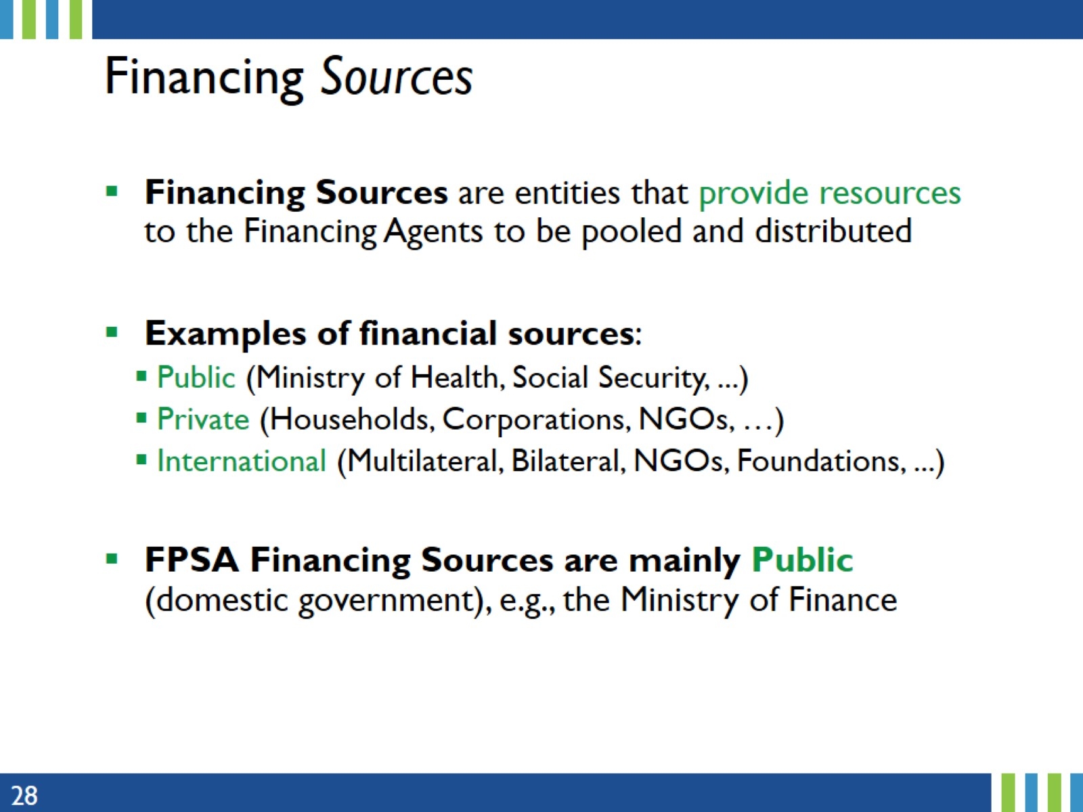
Financing Sources
Notes:
Funding/financing sources consist of financial institutions/ministries that provide funding to finance specific programs and projects.
While several FP financing sources could exist in a country, FPSA focuses ONLY on public/domestic expenditures.

Slide 29
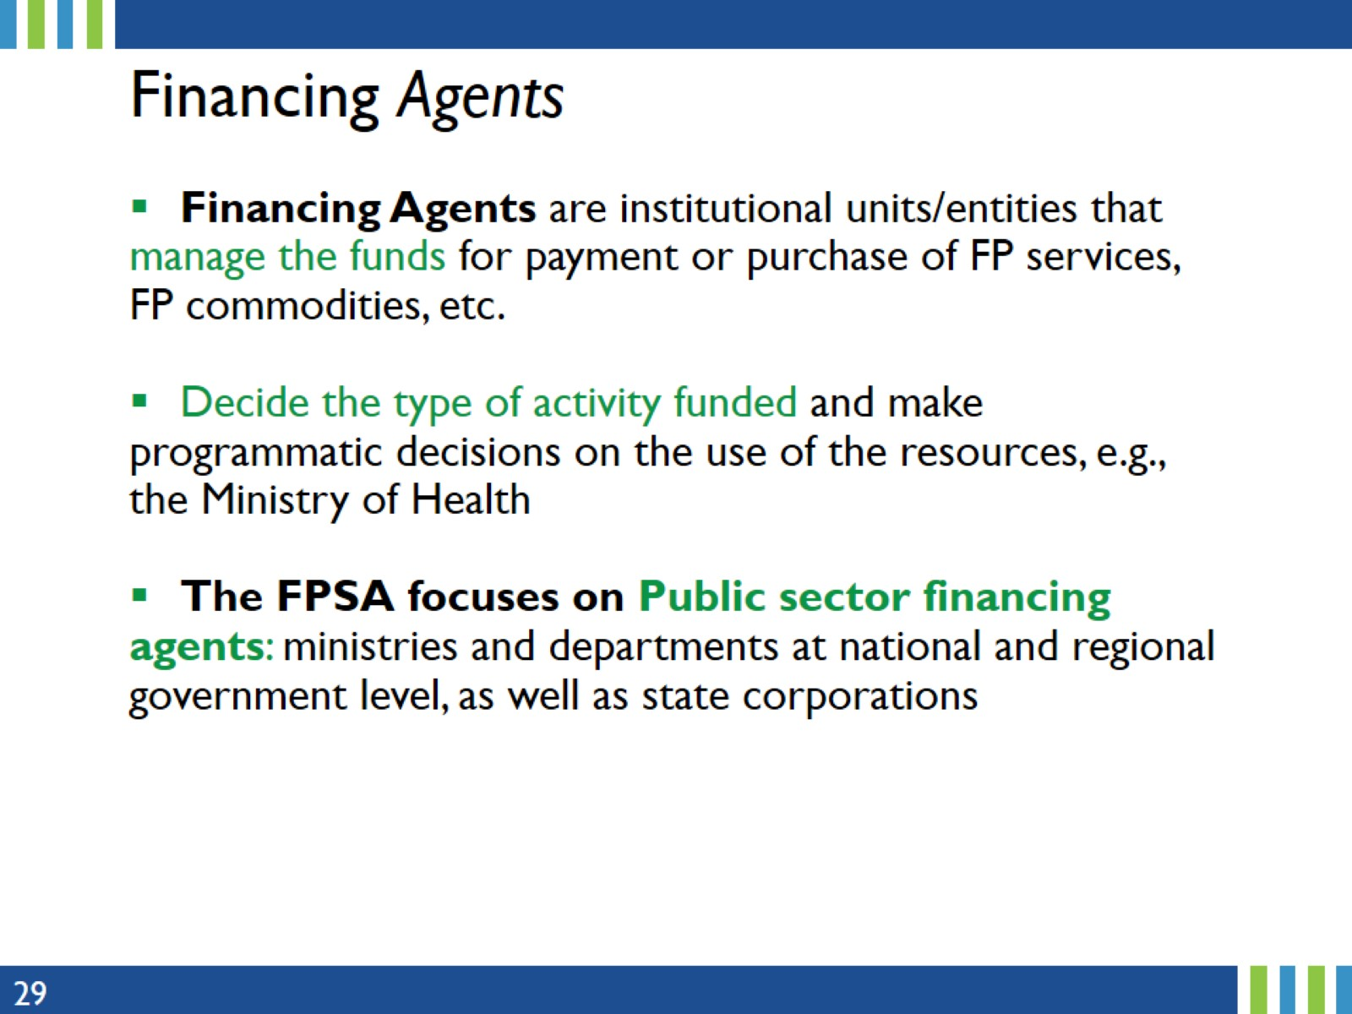
Financing Agents
Notes:
Financing Agent and purchasers are economic/institutional units/entities that manage and decide on the use of funds for payment or purchase of FP services, FP commodities. They collect revenue, pool financial resources, pay for service provision, and make programmatic decisions (allocation and purchase modalities).
Other financing agents NOT to be included in the FPSA are
Private sector Agents: households, private insurance firms, private employers, for-profit and not-for-profit organizations, national NGOs
International: Include wide range of entities such as bilateral, multilateral, foundations such the Gates Foundation, and international NGOs

Slide 30
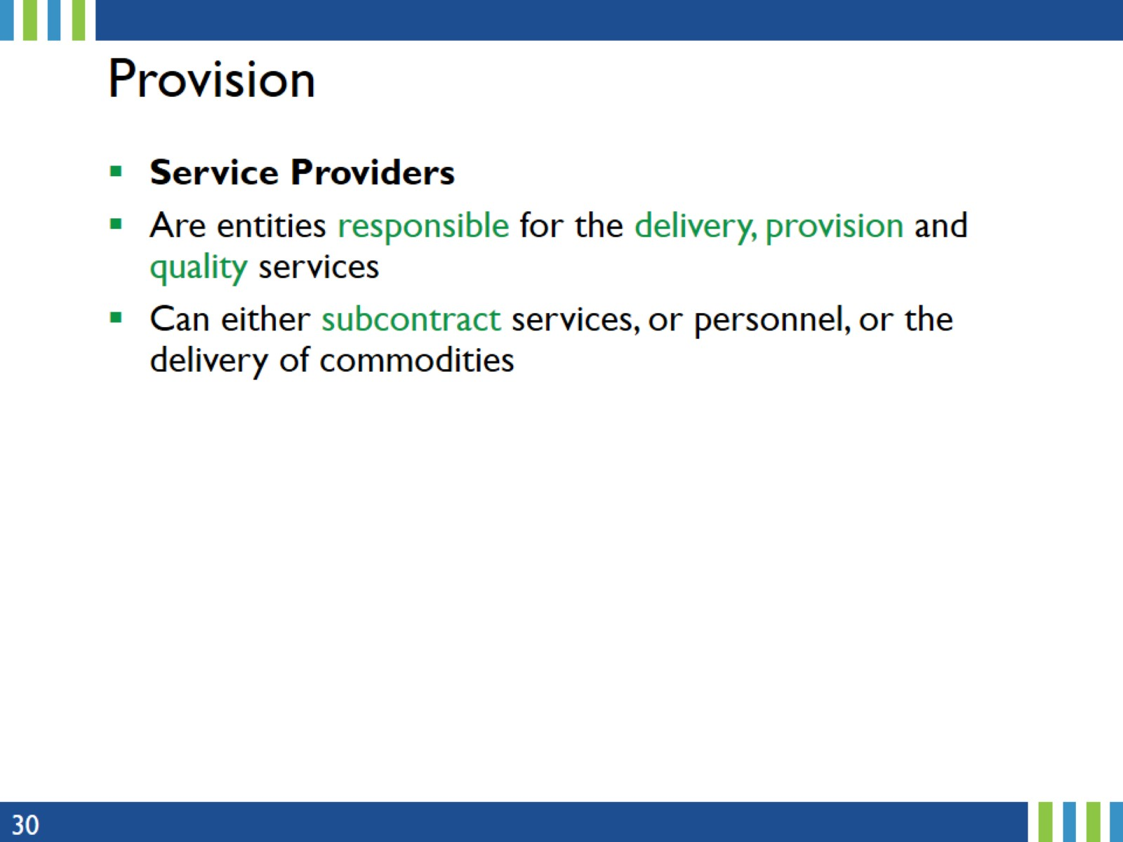
Provision
Notes:
Service providers are health institutions such as hospital, clinic,... that provide FP services to beneficiary populations. That is, providers are entities where the final products (personnel salaries, commodities, FP methods... ) are consumed.
To identify a service provider, first identify the type of service and the final product (FP Spending Category).

Slide 31
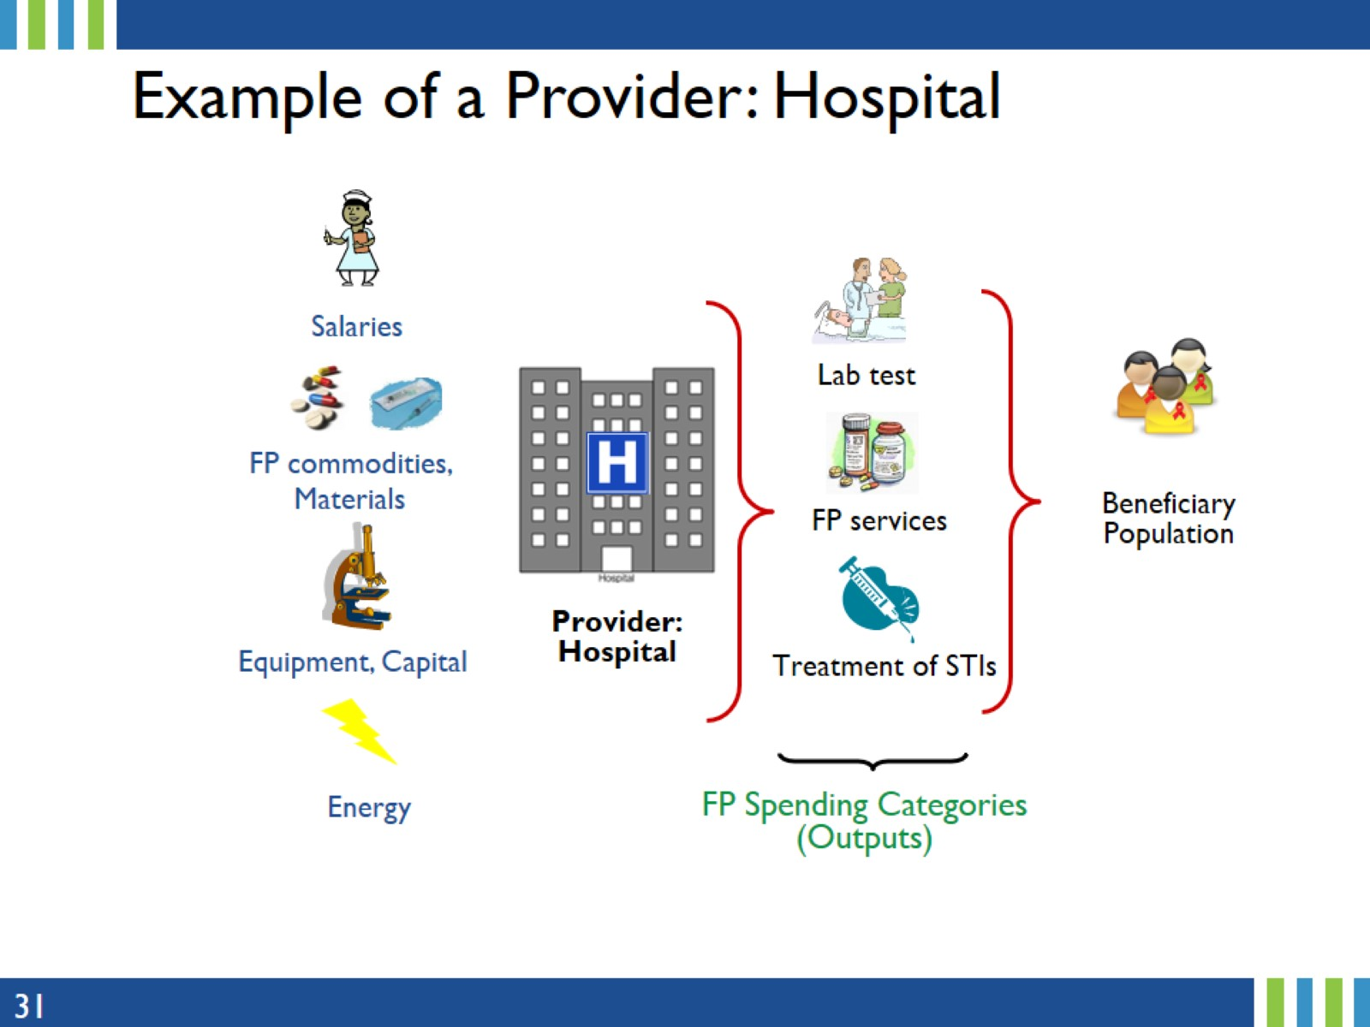
Example of a Provider: Hospital
Notes:
To identify a service provider, first identify the type of service and the final product (FP Spending Category)

Slide 32
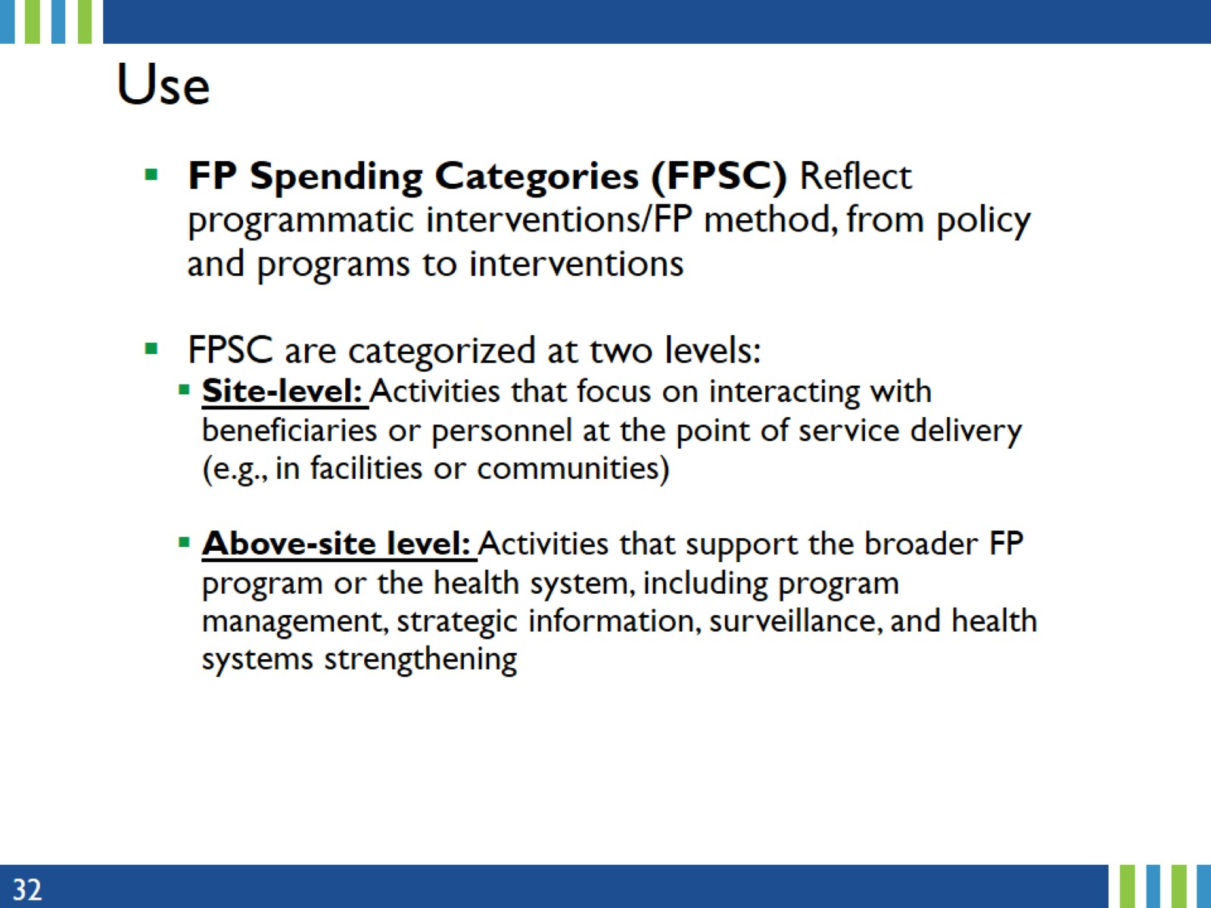
Use
Notes:
FP Spending Categories reflect programmatic interventions/FP method, from policy and programs to interventions (FP-related interventions and activities).
The objective here is to explain FP financial classifications, a structure whereby FP expenditures are systematically organized for clear identification and accounting.
The first level of classification is whether the activity takes place at site-level or above-site level.
Site-level: Activities that occur at the point of service delivery or facility level and are categorized by the implementation of FP activities in specific communities or facilities. This includes both direct FP services to beneficiaries and non-service delivery (technical assistance, site-level training, mentoring (caring for individuals’ long-term development) and supervision) at the site/community level.
Above-site level: Activities that support the broader FP program or the health system, including program management, strategic information, surveillance, and health systems strengthening.

Slide 33
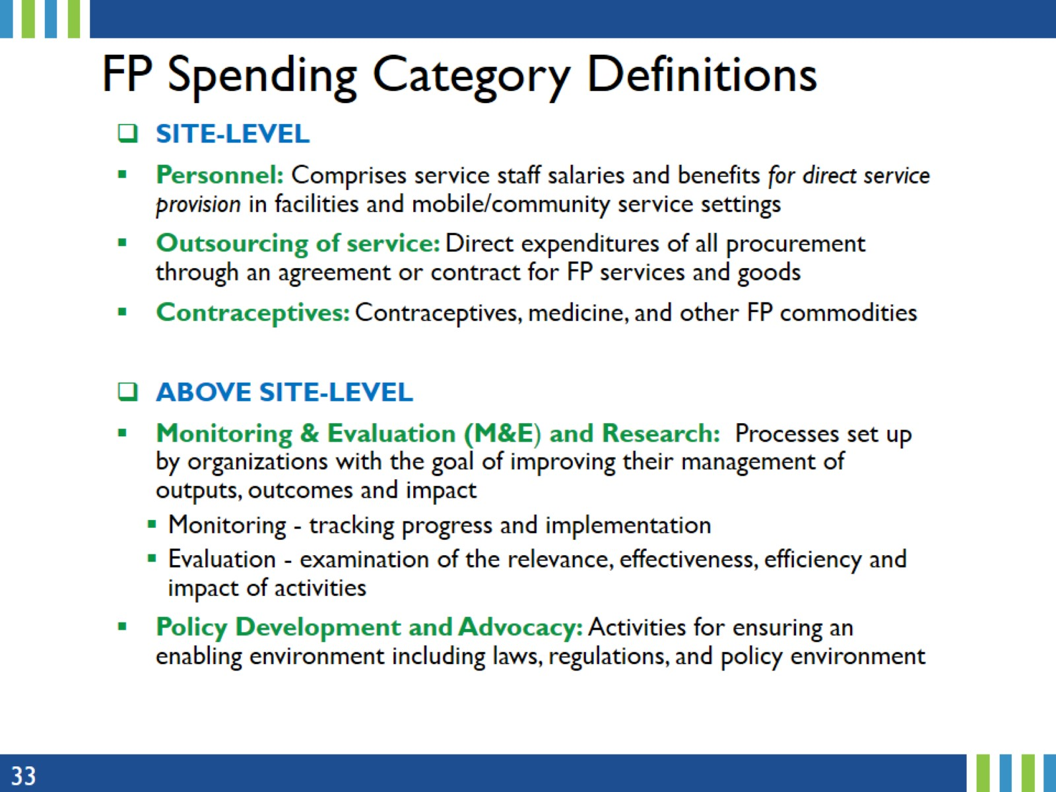
FP Spending Category Definitions
Notes:
Definitions and potential data sources of the FP spending categories are also provided in the FPSA Reference Guide, available on the Track20 website.
But presented here are brief definitions of the FP Spending Categories, categorized by site-level and above-site level.

Slide 34
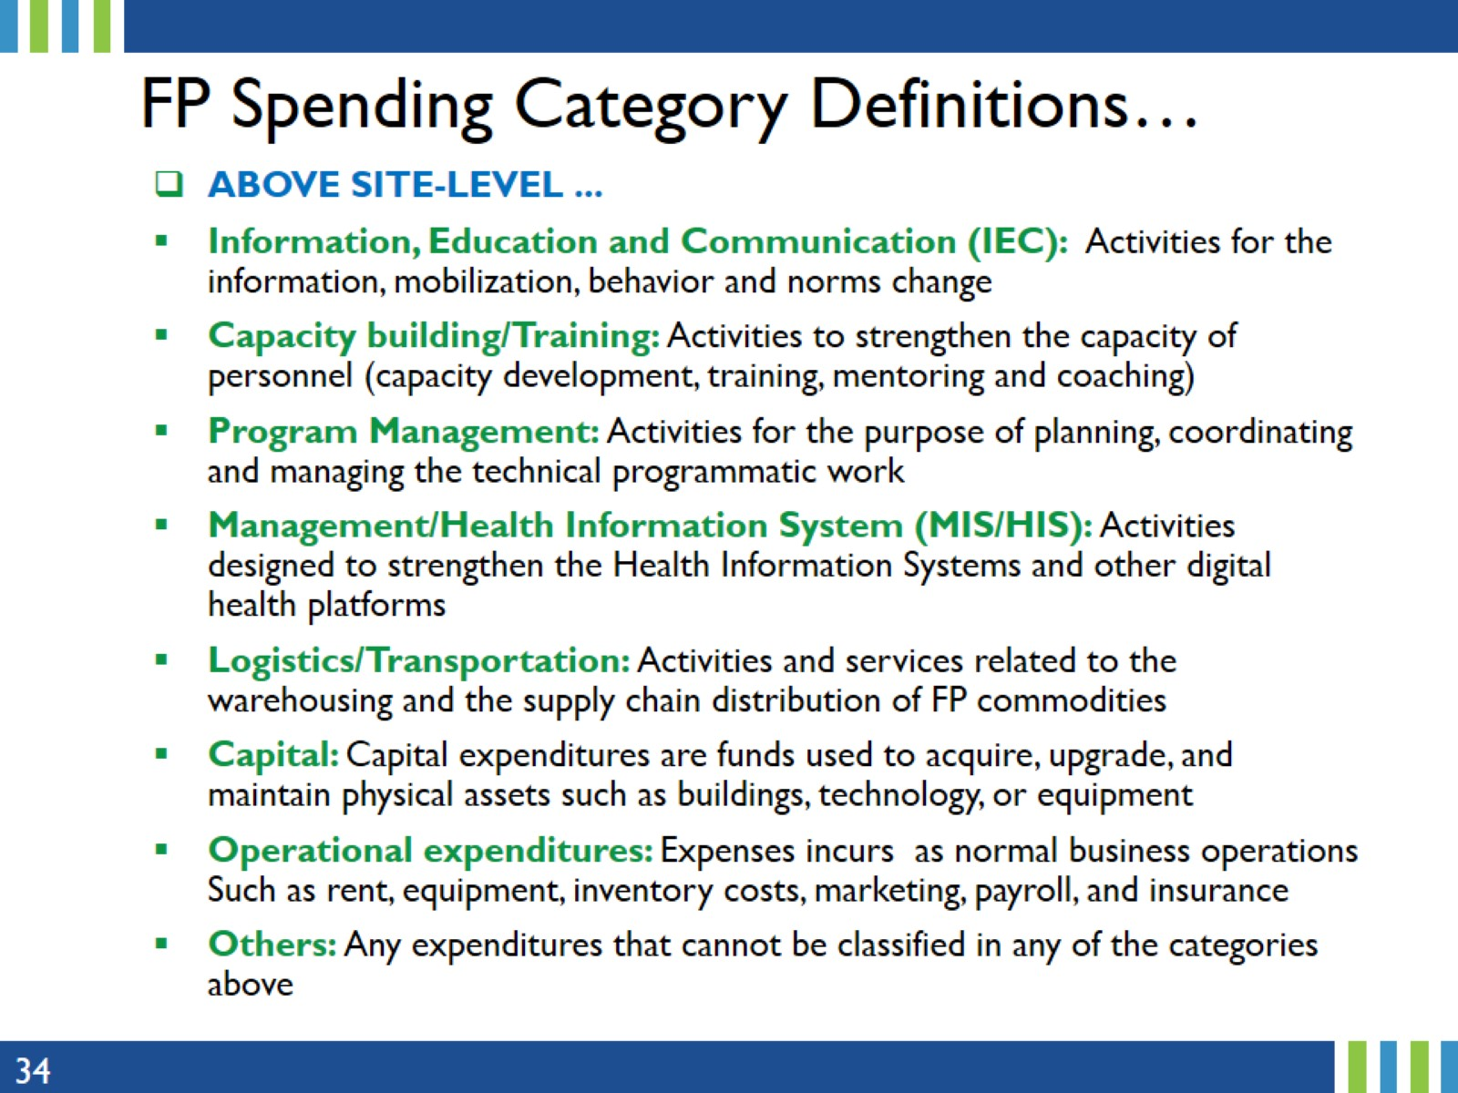
FP Spending Category Definitions…
Notes:
IEC may involve direct, active interaction with the beneficiary population or targeted internet approach, social marketing, targeted mass media campaigns or community mobilization.
Capital expenditures are tangible and intangible assets such as buildings, capital equipment, and capital transfers.

Slide 35

4. Financial Flows: Reconstructing Transactions
Notes:
This section provides details on the Family Planning flow of funds, and how to avoid double counting through reconstruction of the transactions.

Slide 36
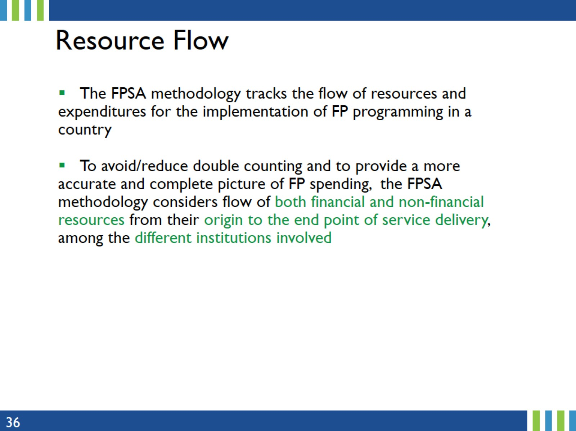
Resource Flow
Notes:
To track the annual FP expenditures incurred by country governments, the flow of the transactions are reconstructed, from the origin to the end point of service delivery/FP spending categories or vice-versa.
More details on the top-down or bottom-up approach will be provided later in the presentation.
The Track20 Family Planning Expenditure Assessment (FPSA) is a comprehensive and systematic resource tracking method used to measure the flow of resources (both financial and non-financial) for FP implementation in a country.

Slide 37
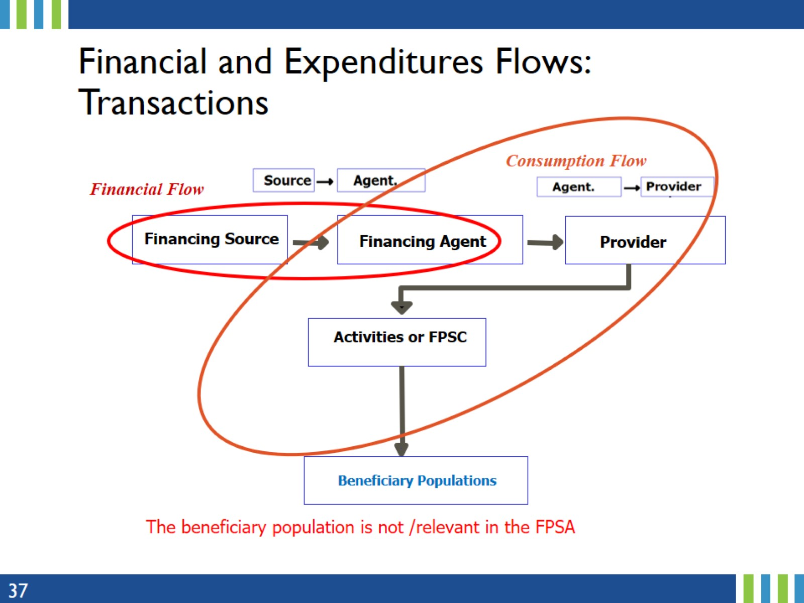
Financial and Expenditures Flows:
Transactions
Notes:
While the FP beneficiary populations are important, data on the FP beneficiaries (household expenditures) are not collected as part of FPSA.
The FPSA is concerned with the FP expenditures from the Financing Sources to the spending categories described in the previous section.

Slide 38
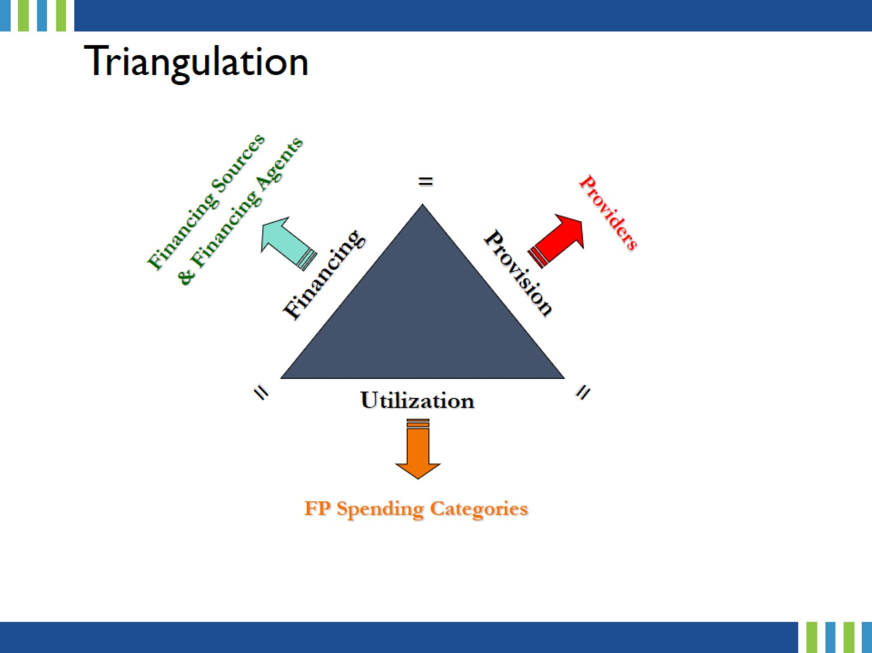
Triangulation
Notes:
Gathering, compiling and cross-checking information from financing sources, providers, and what the funds are spent on (FP spending categories) helps to avoid double counting.
Data triangulation is the use of a variety of data sources. In so doing, expenditures can be corroborated and any weaknesses in the data can be compensated for by the strengths of other data.
The goal of the data triangulation is to increase confidence/validity of the data by using two or more independent measures such as top-down vs bottom-up approach.
The result of the FPSA data triangulation ensures the total expenditures in all the 4 tables in the report are the same.

Slide 39
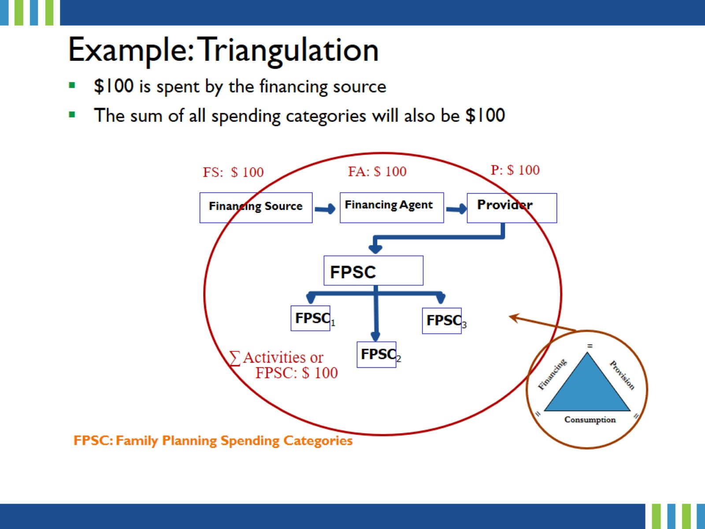
Example: Triangulation
Notes:
In this example, the financing source provides $100 to the financing agent.
The financing agent or agent purchaser provide $100 to the service provider(s).
Service provider deliver services to the tune of $100.
Note that the financing agent often acts like a prime recipient (agency/MOH) that receives funds directly from say the Ministry of Finance and pass them through to the service providers.

Slide 40
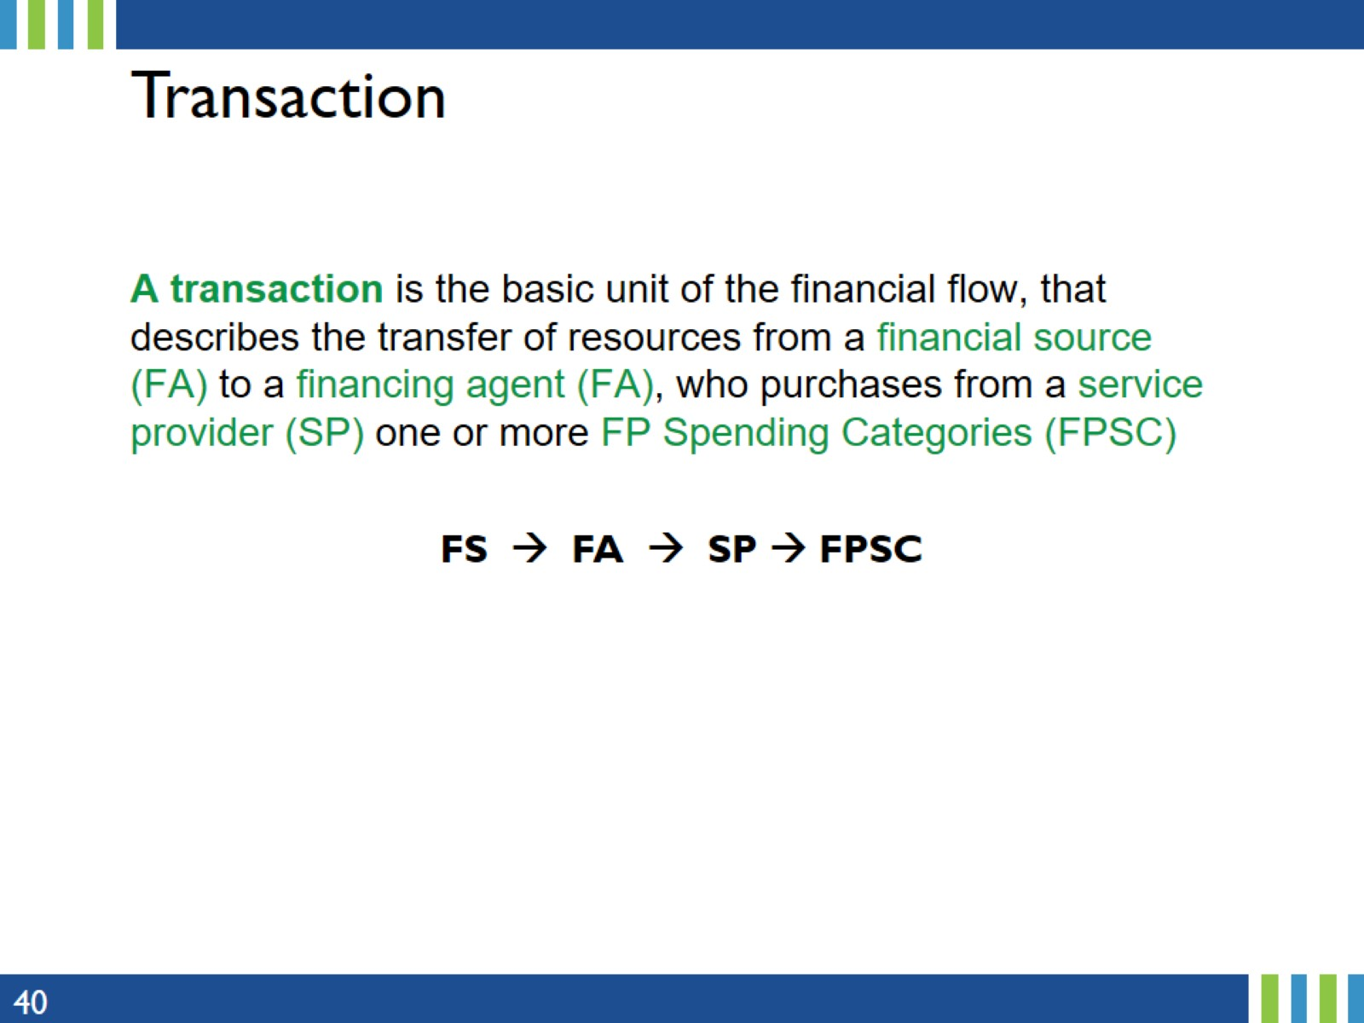
Transaction
Notes:
FS: Financing source
FA: Financing agent
SP: service provider
FPSC: Family Planning Spending Category
The next five slides provide some examples of financing flows. The aim is to provide realistic examples of various ways funds could be distributed (flows) in real life.

Slide 41
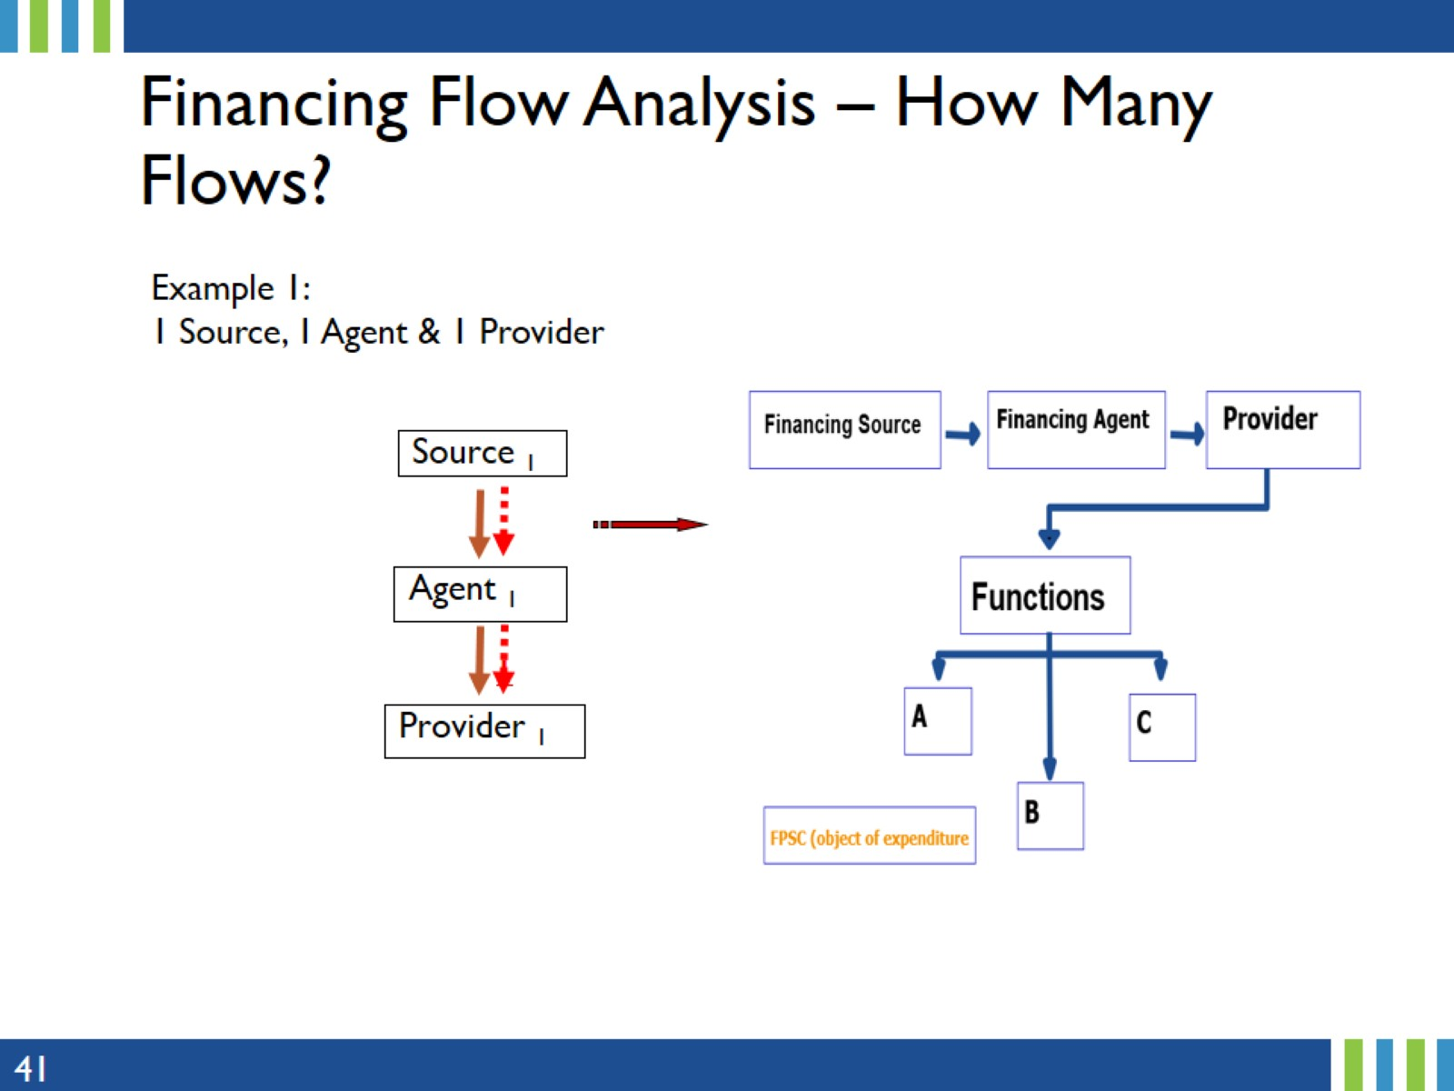
Financing Flow Analysis – How Many Flows?
Notes:
The goal of these examples is to identify the various flow of funds.
Dash arrows represent the count of flows, in this case there is only 1 flow
Solid arrows represents the general flow from financing source to the agent and to the provider.

Slide 42
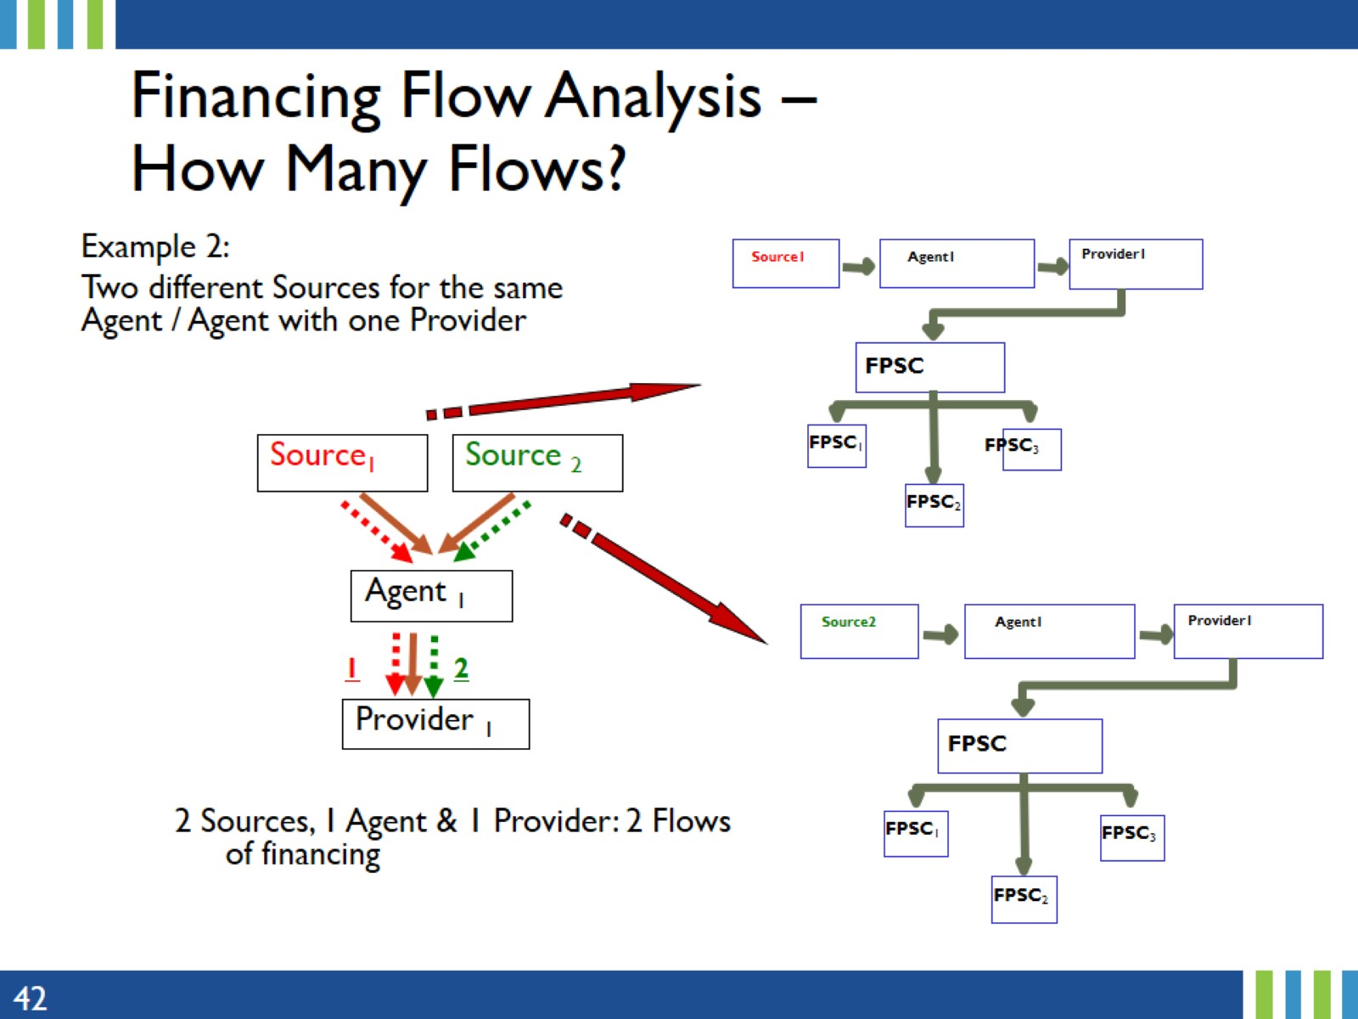
Financing Flow Analysis – How Many Flows?
Notes:
Dash arrows represent the count of flows, in this case there are 2 flows of resources: One from Source 1, and another one from Source 2.

Slide 43
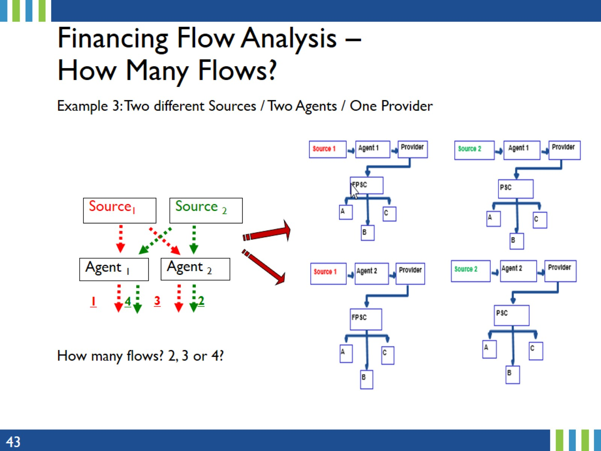
Financing Flow Analysis – How Many Flows?
Notes:
In this example, there are two streams/sources of fundings and two agents. Each source provides funding to the two agents. That is, source 1 provides funding to agent 1 and to agent 2 (2 flows – red dash arrows). Similarly, source 2 provides funding to both agents (2 flows – green dash arrows). Thus, in total, there are 4 flows as shown by the dash arrows count and depicted in the charts on the right panel.

Slide 44
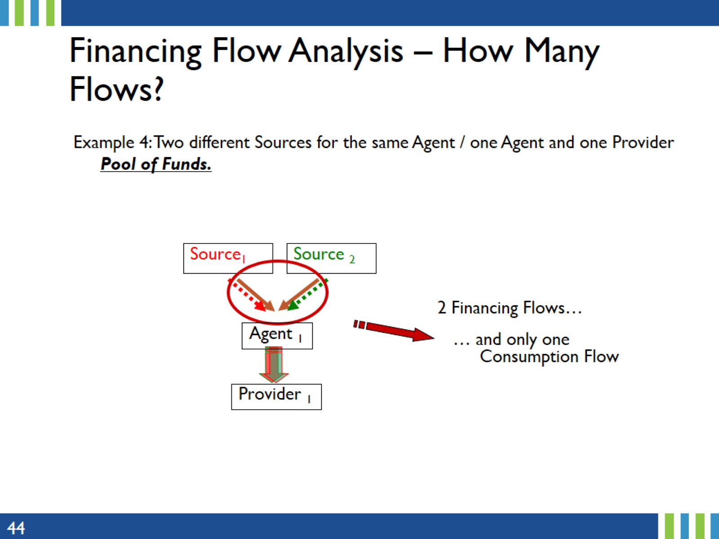
Financing Flow Analysis – How Many Flows?
Notes:
While there are 2 financing flows, 1 from each source, there is only 1 consumption flow. This is a tricky example when it comes to reporting expenditures. While the provider may only report the pool funding received from the agent, the agent will provide financial report to each source. However, the agent should provide funding with codes and object of expenditures so that from the provider report, they can easily disaggregate expenditure data emanating from each source.

Slide 45
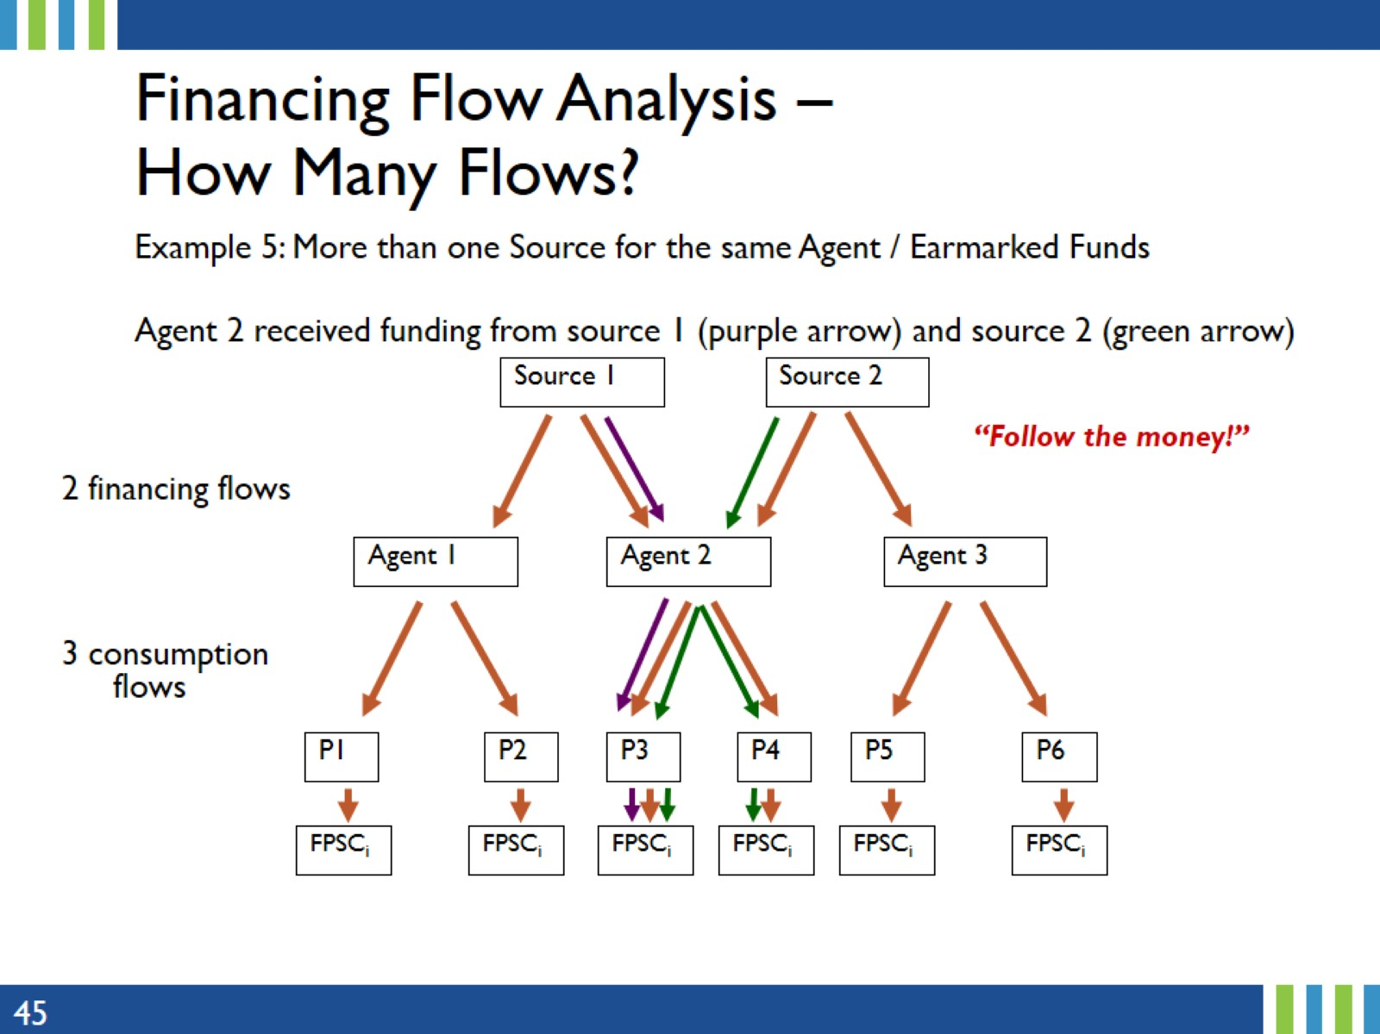
Financing Flow Analysis – How Many Flows?
Notes:
This slides shows that one agent can have multiple sources of funding such as earmarked funds.
An example of this for domestic funding might be funding from the central Ministry of Finance and the second source is the regional/State/provincial Ministry of Finance (in case of decentralized funding).

Slide 46
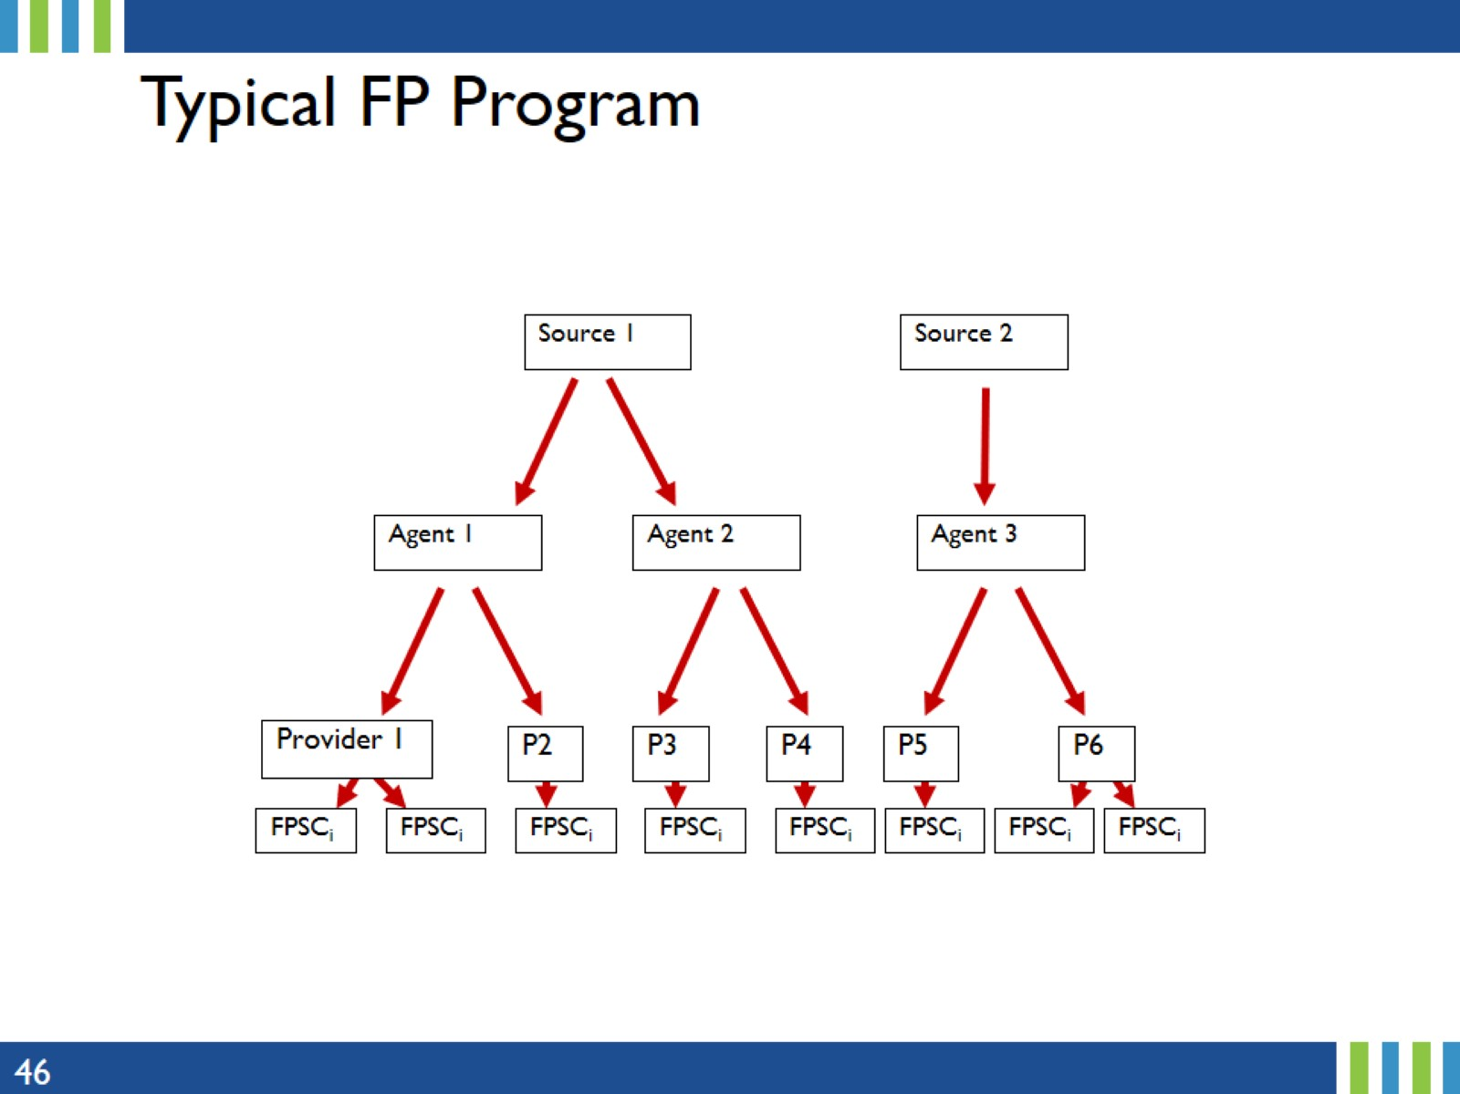
Typical FP Program
Notes:
A typical FP program might look like this with two sources, with Source 1 providing funding to two agents (agents 1 & 2), while source 2 provides funding to one agent.

Slide 47
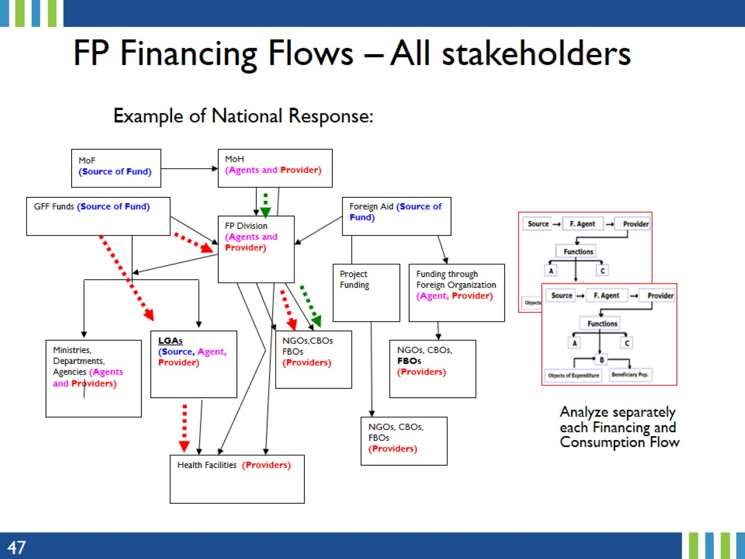
FP Financing Flows – All stakeholders
Notes:
One of the reasons for triangulation is to avoid double counting or counting financial resources from other stakeholders.
For this reason, it is important to analyze separately each financial flow, especially when capturing FP expenditures from all donors (domestic, bilateral and multi-lateral organizations).
Because FPSA focuses on government/public expenditures only, it is important not to include bilateral and multilateral funding.
While the goal of the previous examples was to distinguish the various flow of funds, the next set of examples will focus of intermediaries or pass through agents, whose roles are mainly to transfer funds and the resources they could potentially consume are mainly overhead.

Slide 48
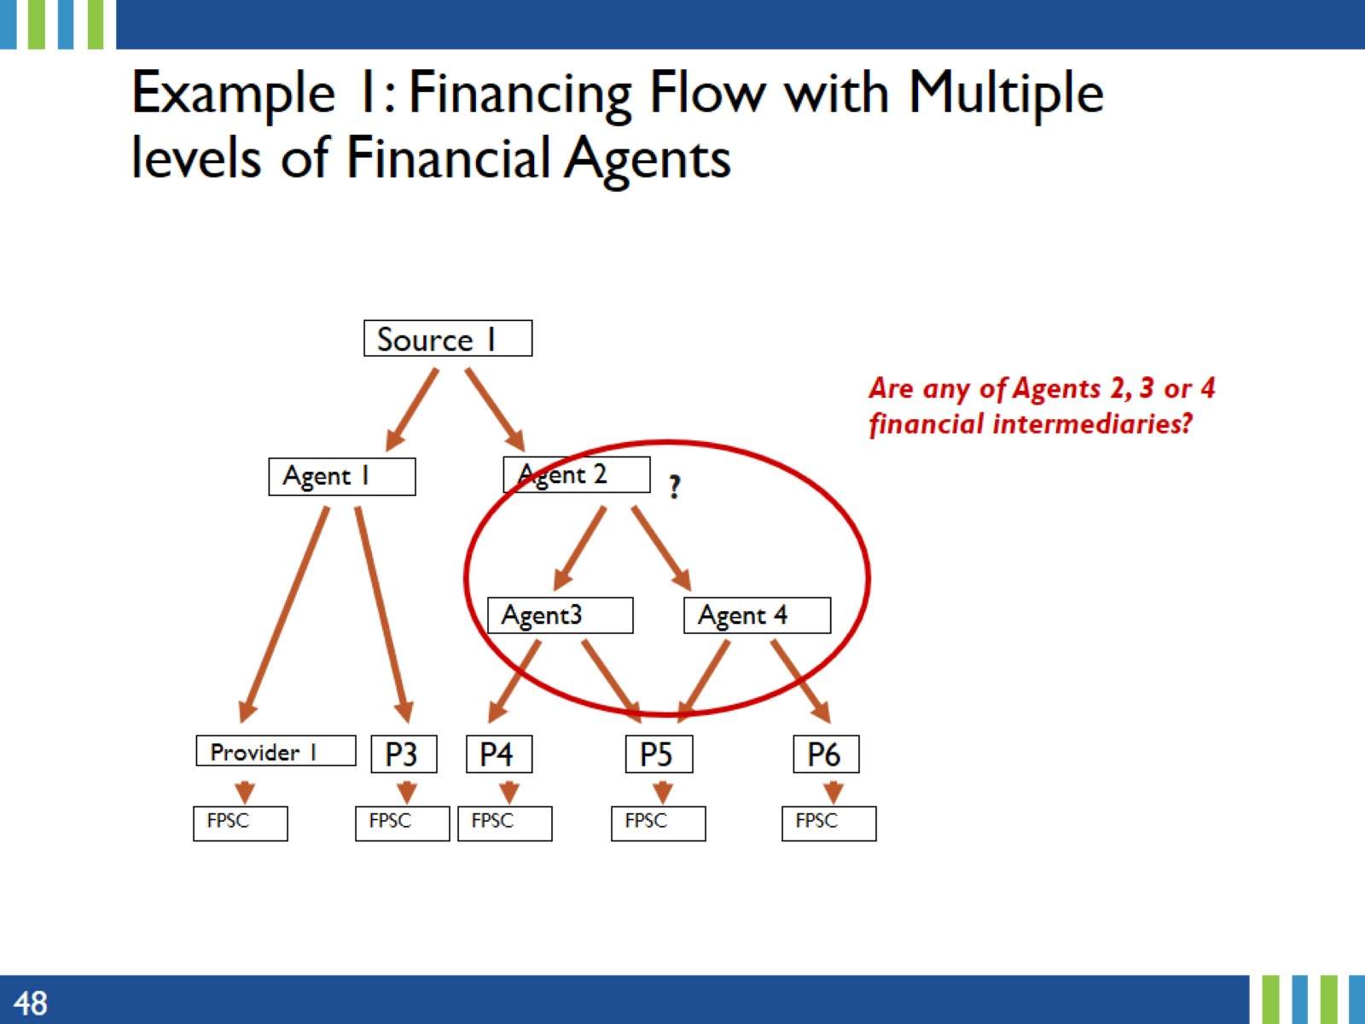
Example 1: Financing Flow with Multiple levels of Financial Agents
Notes:
In this slide, we have two levels of financial flow from Source 1 to Agent 2 and from Agent 2 to agents 3 and 4.
The role of the financial intermediary is to transfer funds and could only incurred overhead expenses.
None of the above agents (2, 3 or 4) are a financial intermediary.
The next 3 slides provide examples of possible financial intermediaries.

Slide 49
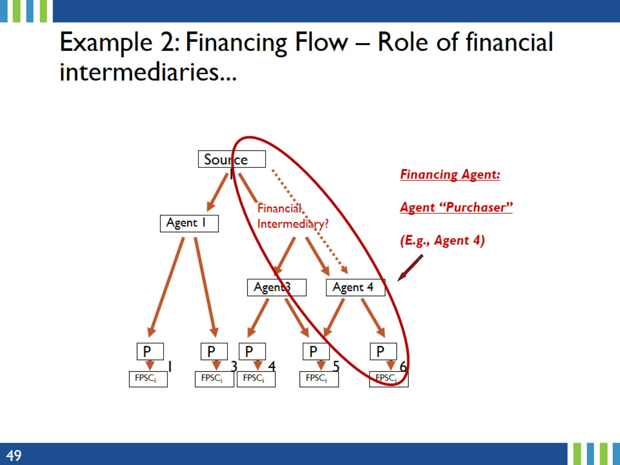
Example 2: Financing Flow – Role of financial intermediaries...
Notes:
In this slide, there is a financial intermediary involved in the transaction between Source 1 and Agents 3 and 4.
The financial intermediary, contrary to the previous slide, is NOT an agent and cannot make decisions on the use of funds.
The role of the financing agent is mainly a pass through, to transfer funds from Source 1 to Agents 3 and 4.

Slide 50
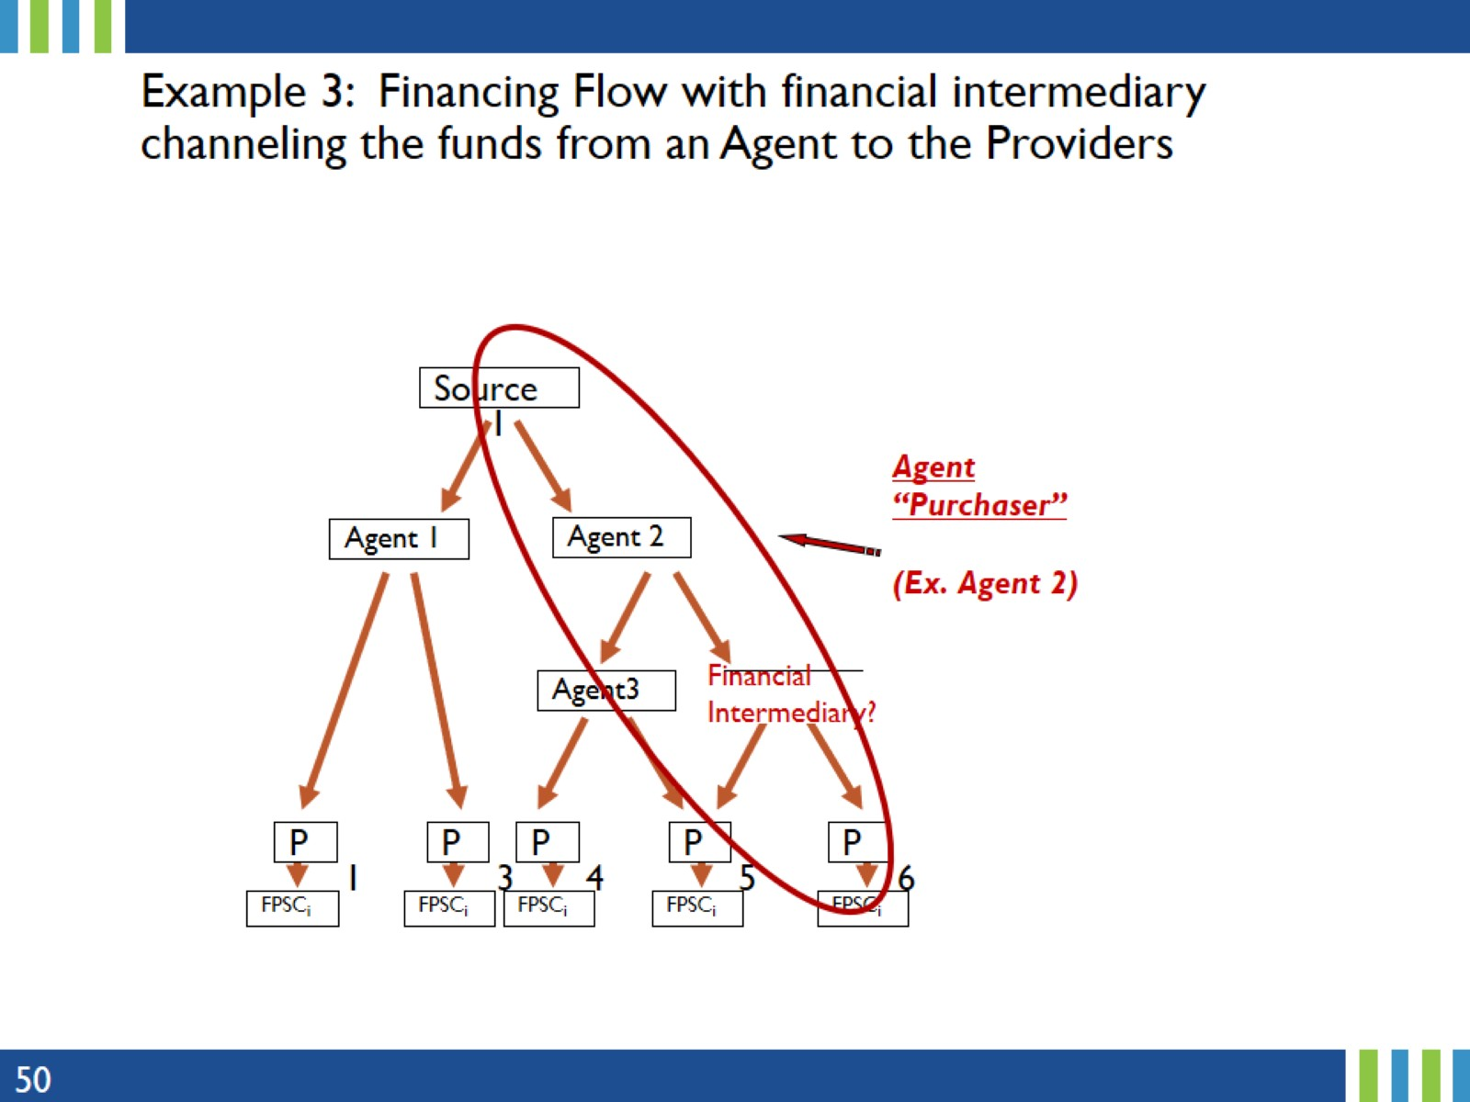
Example 3: Financing Flow with financial intermediary channeling the funds from an Agent to the Providers
Notes:
While Agents 1, 2 and 3 are agent purchasers, a financial intermediary is responsible for channeling part of the funds from Agent 2 to some of the providers.
Agents can make decision on the use of funds, but a financial intermediary cannot.
The next two slides will include the amount of funding that could help identify a financial intermediary.

Slide 51
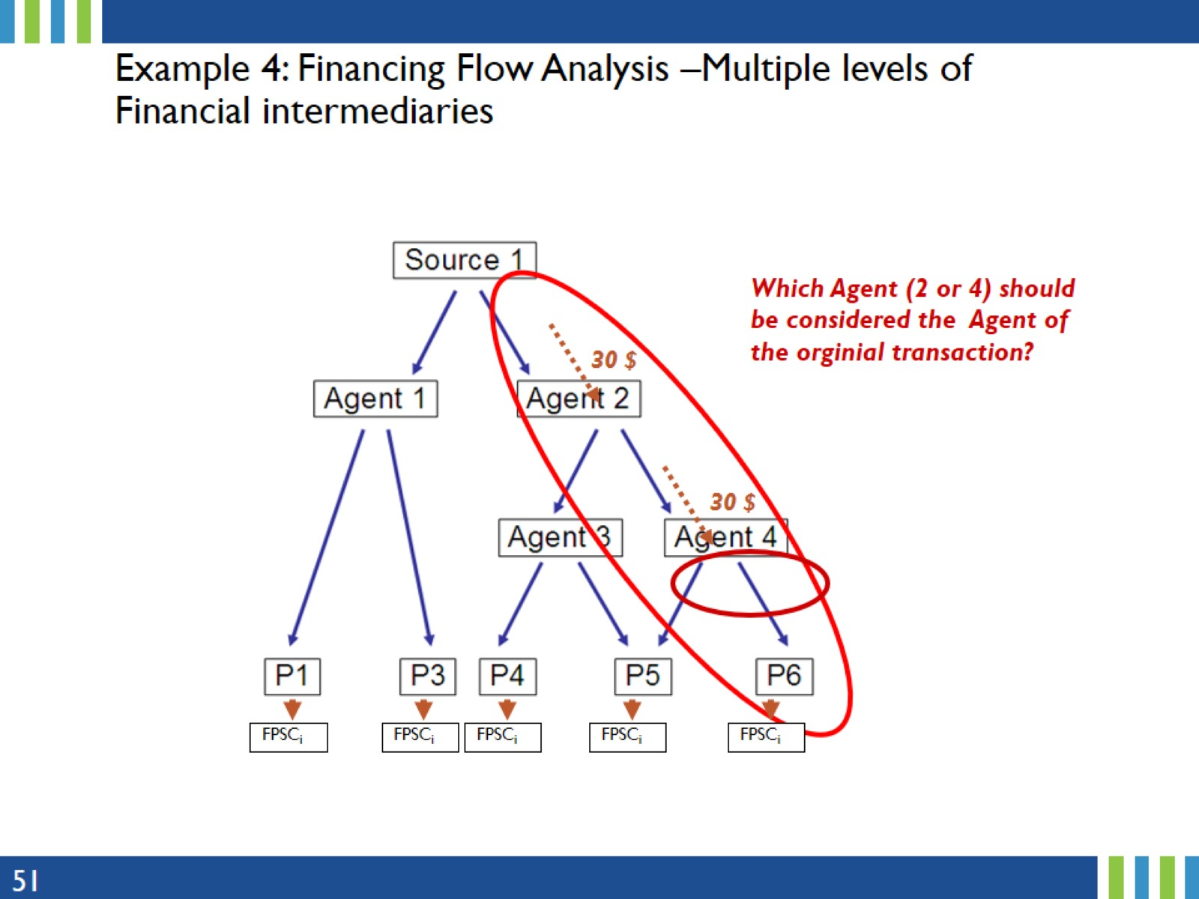
Example 4: Financing Flow Analysis –Multiple levels of Financial intermediaries
Notes:
Agent 2 receives $30 and distributes $30. Because they spent nothing, they are not included in the transaction.
Thus Agent 4 is the agent purchaser in this flow.

Slide 52
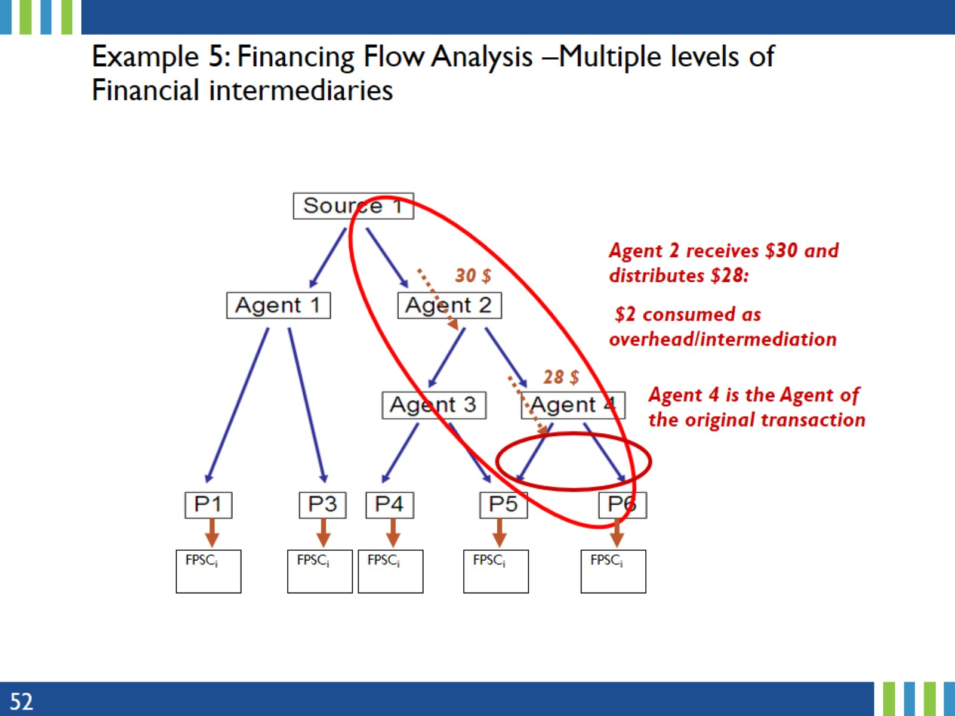
Example 5: Financing Flow Analysis –Multiple levels of Financial intermediaries
Notes:
Agent 2 receives $30, spent $2 and distributes $28. In this case, both Agents 2 and 4 are included in the transaction.
While Agent 4 is still the agent purchaser in this flow, expenditures from Agents 2 and 4 will be included in the transaction so that the total will match the amount provided by the Source, $30.
Next, we discuss the bottom-up vs top-down approaches.

Slide 53
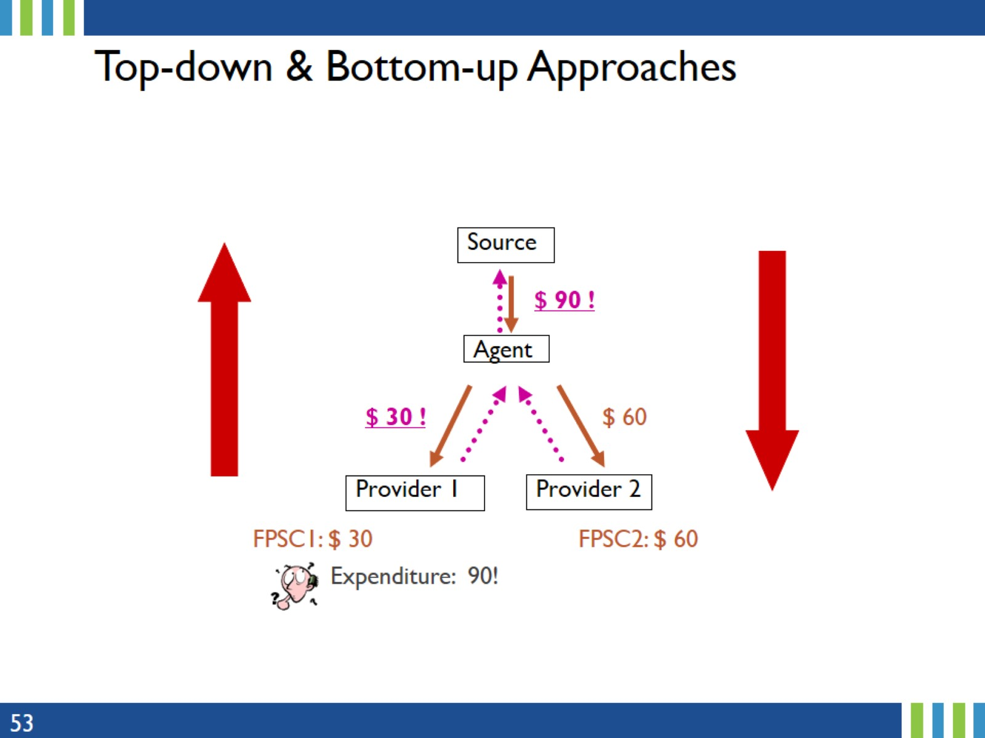
Top-down & Bottom-up Approaches
Notes:
The top-down approach is a method that starts from the total expenditures of the project and allocates it to the major components or phases of the project.
The bottom-up, or ingredient-based approach, determines the overall expenditures by examining the most granular level of detail, compiling all this information, and then producing an overall expenditure.
Note: In the figure above, the solid arrows represents the top-down reconstruction, while the dash arrows indicate the bottom-up reconstruction

Slide 54

Triangulating this example
Notes:
This slides shows how the expenditures can be represented on the triangulation map
$90 from the Source to the Agent
The Agent distributes the $90 to service Providers
Amount at each Level should total $90. In the FPSA report, the total amount at each level (Source, Agent, Providers and FPSC) should also be the same.

Slide 55

Key Issues
Notes:
Following the money through the bottom-up or top-down approach ensures (1) no double counting (2) that the total at all levels (Source, Agent, Providers and FPSC) are the same.

Slide 56

Cross Checking Data
Notes:
As a caution, one should avoid double counting of expenditures.
In summary, only collect actual expenditures, and in doing so, it is important to understand the financial flow of the resources, then follow the money via triangulation using either bottom-up or top-down approach.
Finally, cross check the data from all sources and levels (Source, Agent, Providers and FPSC).

Slide 57

5. Estimating Shared Expenditures
Notes:
This section presents a standard process of how to estimate FP-specific expenditures from health systems expenditures.

Slide 58

Rationale
Notes:
In general, the financial management information system provides information for the general health system. Except for some categories – such as contraceptives – very few health systems provide FP specific expenditures information. For this reason, Track20 designed a standard process to estimate FP-specific expenditures.

Slide 59

Methodology: Equivalency Ratio
Notes:
The equivalency ratio was developed as a ‘uniform’ methodology to calculate the FP allocation ratio to allocate FP specific expenditures from shared expenditures.
If facility-level data required to calculate the FP allocation ratio are disaggregated by facility type, user will generally calculate the allocation ratio by facility type, thus obtaining FP allocation ratio by facility type.
However, the FP allocation ratio calculator automatically generates one FP allocation ratio irrespective of the facility level (primary, secondary, and tertiary), thereby greatly simplifying the calculations by providing a single FP allocation ratio, which is then applied across the board.

Slide 60

FP Allocation Ratio Calculator
Notes:
The Track20 FP Allocation Ratio Calculator was developed to calculate the equivalency ratio automatically.
If the user’s country is not in the dropdown or has zero value because of no data, select a proxy county. For example, Somalia does not have an equivalency ratio and Djibouti is often selected as proxy.

Slide 61

Steps to calculate shared expenditures
Notes:
When collecting data, it is not necessary to distinguish the facility types as the FP allocation ratio will be calculated in cell C15 or cell F15 of the tool depending on the option used. If the number of FP visits are NOT included in the total number of general out-patient visits, use Option A, otherwise, use Option B.
The inpatient bed days will be automatically converted into its equivalent number of outpatient visits (outpatient visits = inpatient bed days X equivalency ratio x ALOS).

Slide 62

Calculate shared expenditures...
Notes:
In step 3, if no data appear, or your country is not listed, select a “proxy” country which has similar characteristics as yours. For example, Somalia has no data to generate the equivalency ratio and a proxy country to be used are either Eritrea of Djibouti.
The FP allocation ratio will be calculated in cell C15 or cell F15 depending on the option used. If the number of FP visits are NOT included in the total number of general out-patient visits, use Option A, otherwise, use Option B.

Slide 63

Calculate shared expenditures...
Notes:
When the allocation ratio is obtained, this is then used to multiply system-wide expenditures such as personnel to obtain the personnel FP-specific expenditures.

Slide 64

Illustration
Notes:
The expenditure data presented in this example are NOT from Senegal, but the Senegal equivalency ratio is used ONLY to illustrate the calculation of the FP allocation ratio and FP-specific expenditures from shared/system-wide expenditures.

Slide 65

Illustration…
Notes:
While several details are provided in Step 4, the sub-steps (i) and (ii) are simply to showcase the background calculations behind the tool. After entering the data as applicable into the yellow cells of the calculation tool, the FP allocation ratio will be generated automatically.

Slide 66

Illustration…
Notes:
After obtaining FP-specific expenditures, these are then entered into the Data Processing Tool.
More details on the Data Processing Tool (DPT) will be provided later in the presentation, but next, we discuss capital expenditures.
The reason for singling out Capital out of the other FP spending categories is because capital expenditures comprises many sub-categories which are lumped together are reported simply as Capital in the FPSA report, Table 4.

Slide 67

6. Capital Expenditures
Notes:
This section provides information on capital expenditures.

Slide 68

What is Capital?
Notes:
The reason for this presentation focusing on a specific FP spending category “capital” is because Capital comprises of many sub-categories which for the purpose of FPSA are not explicit but presented as one main category “Capital”.
Capital are the assets held by the health system such as building, construction, major renovation and maintenance of tangible and intangible assets used repeatedly, or continuously in production processes of health care or of social amenities over a period of time longer than one year.
The main categories of the classification features are buildings, medical and non-medial equipment.

Slide 69

Capital is Policy Relevant
Notes:
Capital Formation is described as Capital accumulation during an accounting period, which refers to net capital stock additions such as equipment, buildings, and other goods used in the production process over several years
Gross fix capital formation Gross fixed capital formation in the health care system is measured by the total value of the fixed assets that health providers have acquired during the accounting period, that are used continuously for more than one year in the provision of health services

Slide 70

Include/Exclude Capital?
Notes:
Capital Expenditure (technology, medical & non-medical equipment, construction & renovation)
All Capital expenditure should be collected according to the information on this slide, but should be reported in the Data Processing Tool as sum of all the sub-components under FPSC 3.0

Slide 71

Capital Expenditures Data Sources
Notes:
Here, we provide a list of potential data sources for capital expenditures. Just to note that this is not an exhaustive list, but a good starting point to gather capital expenditure data.

Slide 72

7. FPSA Tools & Report
Notes:
This section provides information on the FPSA tools: data collection, FP allocation and Data Processing Tool, as well as the report outline.

Slide 73

Data Collection Tools
Notes:
The FPSA data collection tools in Excel are in two parts.
Form 1 is used to capture data from a service provider. Note that a service provider can be a source and an agent, in which case both Forms 1 and 2 will have to be completed.
Form 2 is used to collect data from either a financial source, a financial agent and the FPSC. In a situation where the financial source is also a financial agent, Form 2 should be completed twice, once capturing data as a source only and secondly capturing data as an agent. The Family Planning Spending Categories (FPSC) are captured on this tool as well.

Slide 74

FP Allocation Ratio Calculator
Notes:
To ensure consistency of the equivalency ratio calculations across all countries, Track20 developed the FP allocation ratio calculator tool using the 2010 WHO-CHOICE cost estimates as default data that generates the equivalency ratio. This was covered in more detail earlier in the training.

Slide 75

FPSA Data Processing Tool
Notes:
The DPT was developed using the national health accounts framework and principles.
Although the FPSA focuses on domestic FP expenditures, the FPSA Data Processing Tool (DPT) tool can be used to tracks actual expenditure from public, private and international donors.
While it may require more time for data entry into the DPT, the advantage is that once the data entry process is completed, the outputs needed for the report are generated from the pivot tables already built into the data processing tool by simply refreshing the data and moving to the relevant tabs to extract the data needed for each of the four tables in the report, namely:
Table 1: Financing Source
Table 2: Financing Agent
Table 3: Service Providers
Table 4: FP Spending Categories

Slide 76

FPSA Report/Tables
Notes:
The report outline is harmonized, and content of each table standardized for country trends, and easy/better comparisons.

Slide 77

8. FPSA Result Validation & Dissemination
Notes:
This section provides information on the FPSA results validation process and dissemination.

Slide 78

Result Validation:
FPSA Consultant Role
Notes:
FPSA consultants collect FP expenditure data and ensure that the FPSA results are validated by the country FP stakeholders (often at the Government’s Annual Consensus Meeting or as a standalone FP Expenditure validation meeting).

Slide 79

Result Validation:
Track20 M&E Officer Role
Notes:
Track20 M&E Officers when available in a country play a pivotal role in facilitating introductions of consultants to FP key stakeholders.
Their TORs/SOW include
Annual production of FP indicators.
Review of data quality.
Participation in FP meetings/facilitating the dissemination of FP data.

Slide 80

How can Track20 M&E Officers help the FPSA process?
Notes:
Track20 M&E Officers when available in a country play a pivotal role in facilitating introductions of consultants to FP key stakeholders, and ensuring that consultant
Obtain FP statistics data (# in-patient/outpatient, # FP visit,…) mainly from HIMS/DHIS2 or other reports.
Are invited to the Track20 Consensus Meeting to present the FPSA results.

Slide 81

Result Dissemination
Notes:
Track20 publishes the FPSA results in the Track20 FPSA online interactive database.
Track20 submits the FPSA data to FP2030 for their annual reporting.

